Slide 1
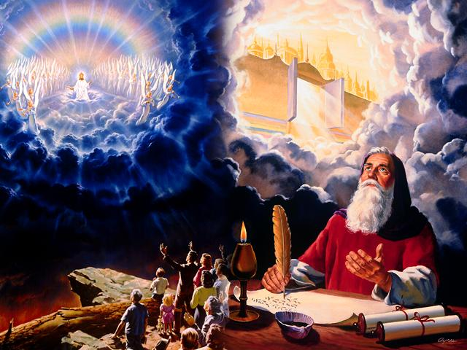
Sự mặc thị
Dr. Rick Griffith • Singapore Bible College • biblestudydownloads.com
Notes:
284 slides need translating into Indonesian as of June 2012:
2-19 (18 slides)
22-28 (7 slides)
40-44 (5 slides)
46
57-58 (2 slides)
60
62-63 (2 slides)
66-68 (3 slides)
78 (bottom)
80 (bottom)
81-84 (4 slides)
104-109 (6 slides)
117-118
122
124
128-358 (230 slides—all except 336)

Slide 2
Thailand • Mongolia • Myanmar • Indonesia
My wife Susan mentors many women
Notes:
INTERVIEWER: And Susan, what ministries has the Lord granted you?
SUSAN: I have been teaching the wives of leaders at SBC. These 5 women come from 5 different nations!
SUSAN: I also lead the woman's Bible study at our church

Slide 3
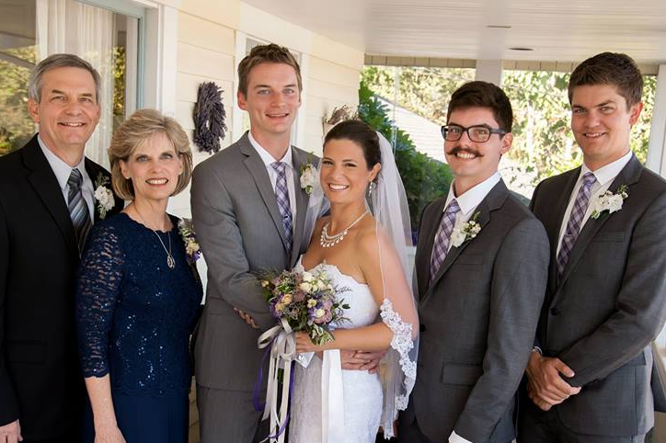
The Griffith Family Sept 2014
2014
Rick
Stephen 25
Susan
John 22
Kurt & Cara 28

Slide 4
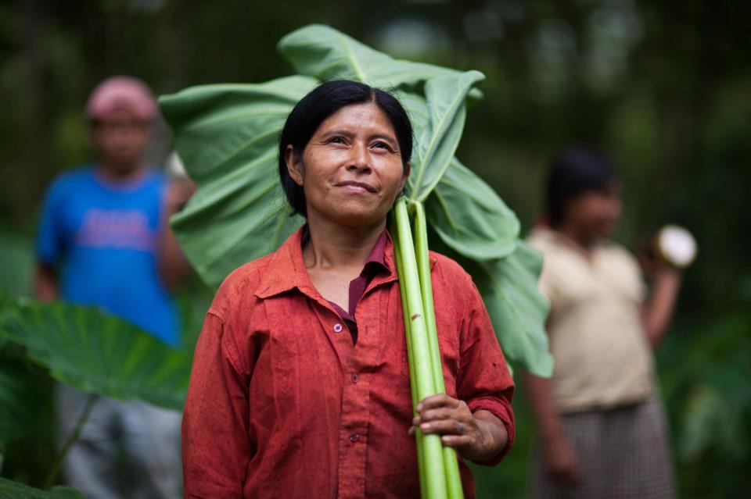
Kurt is our IT son
6

Slide 5
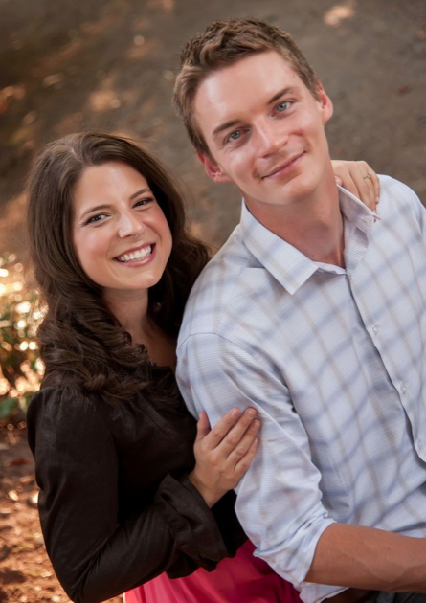
Kurt is studying IT in Chicago
9g

Slide 6
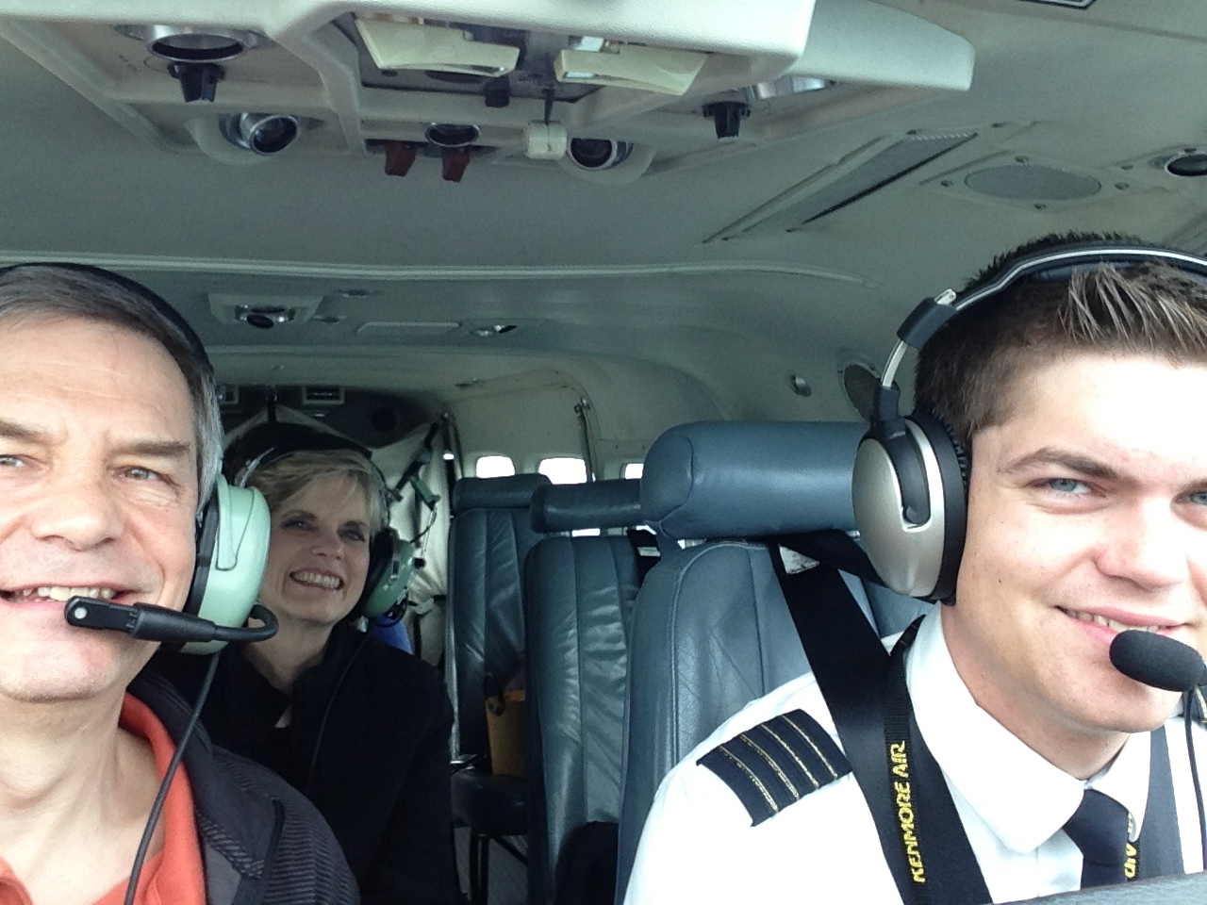
Stephen the Pilot

Slide 7
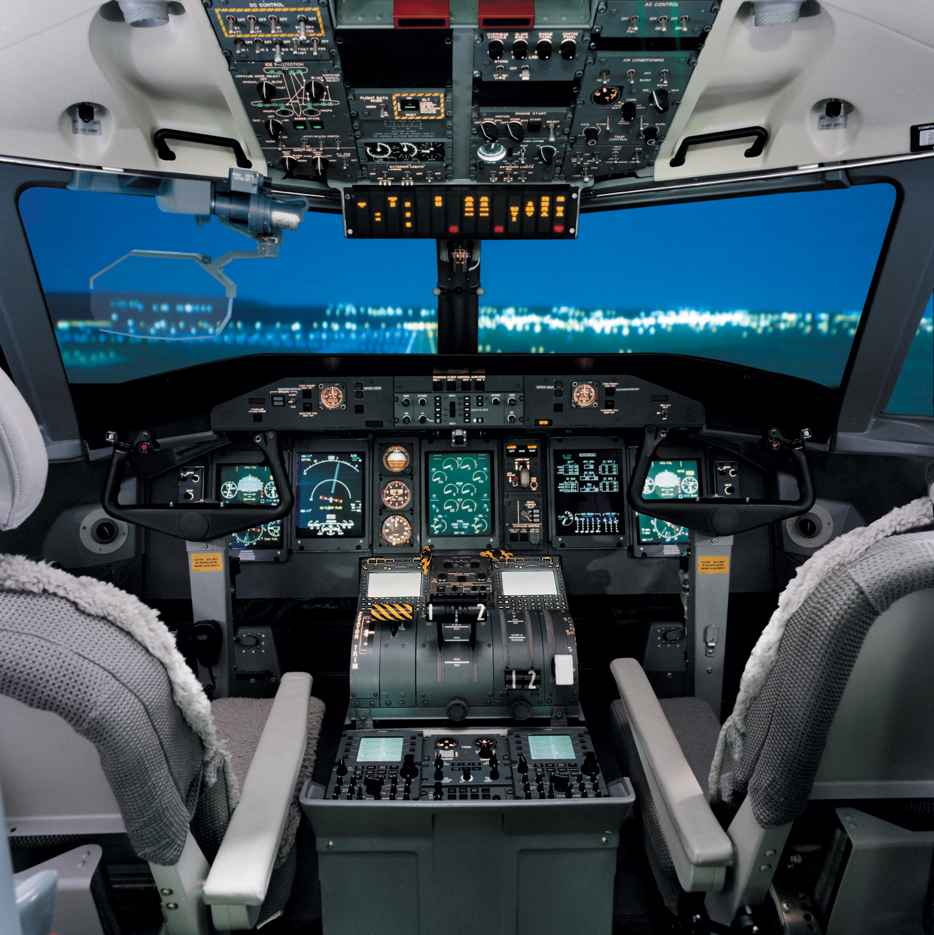
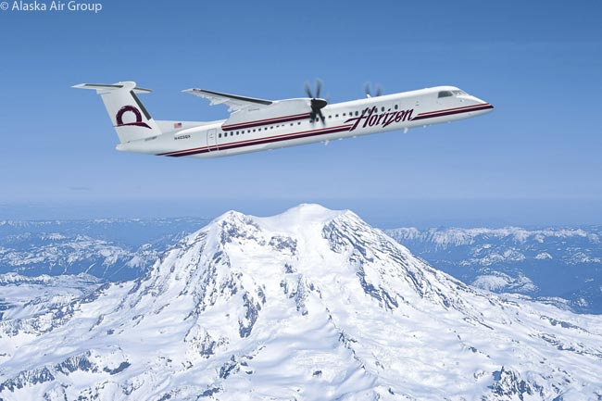
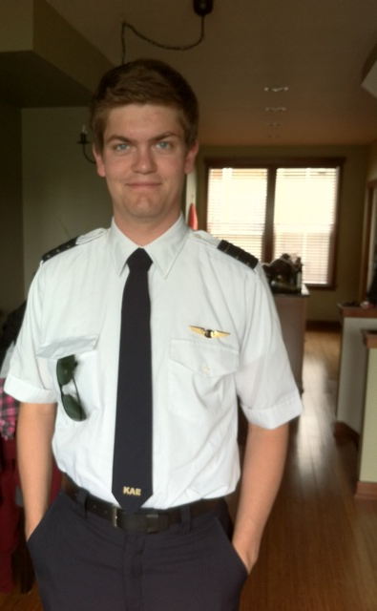
Stephen is a pilot with Horizon Air, Seattle
6

Slide 8
Above Seattle
6

Slide 9
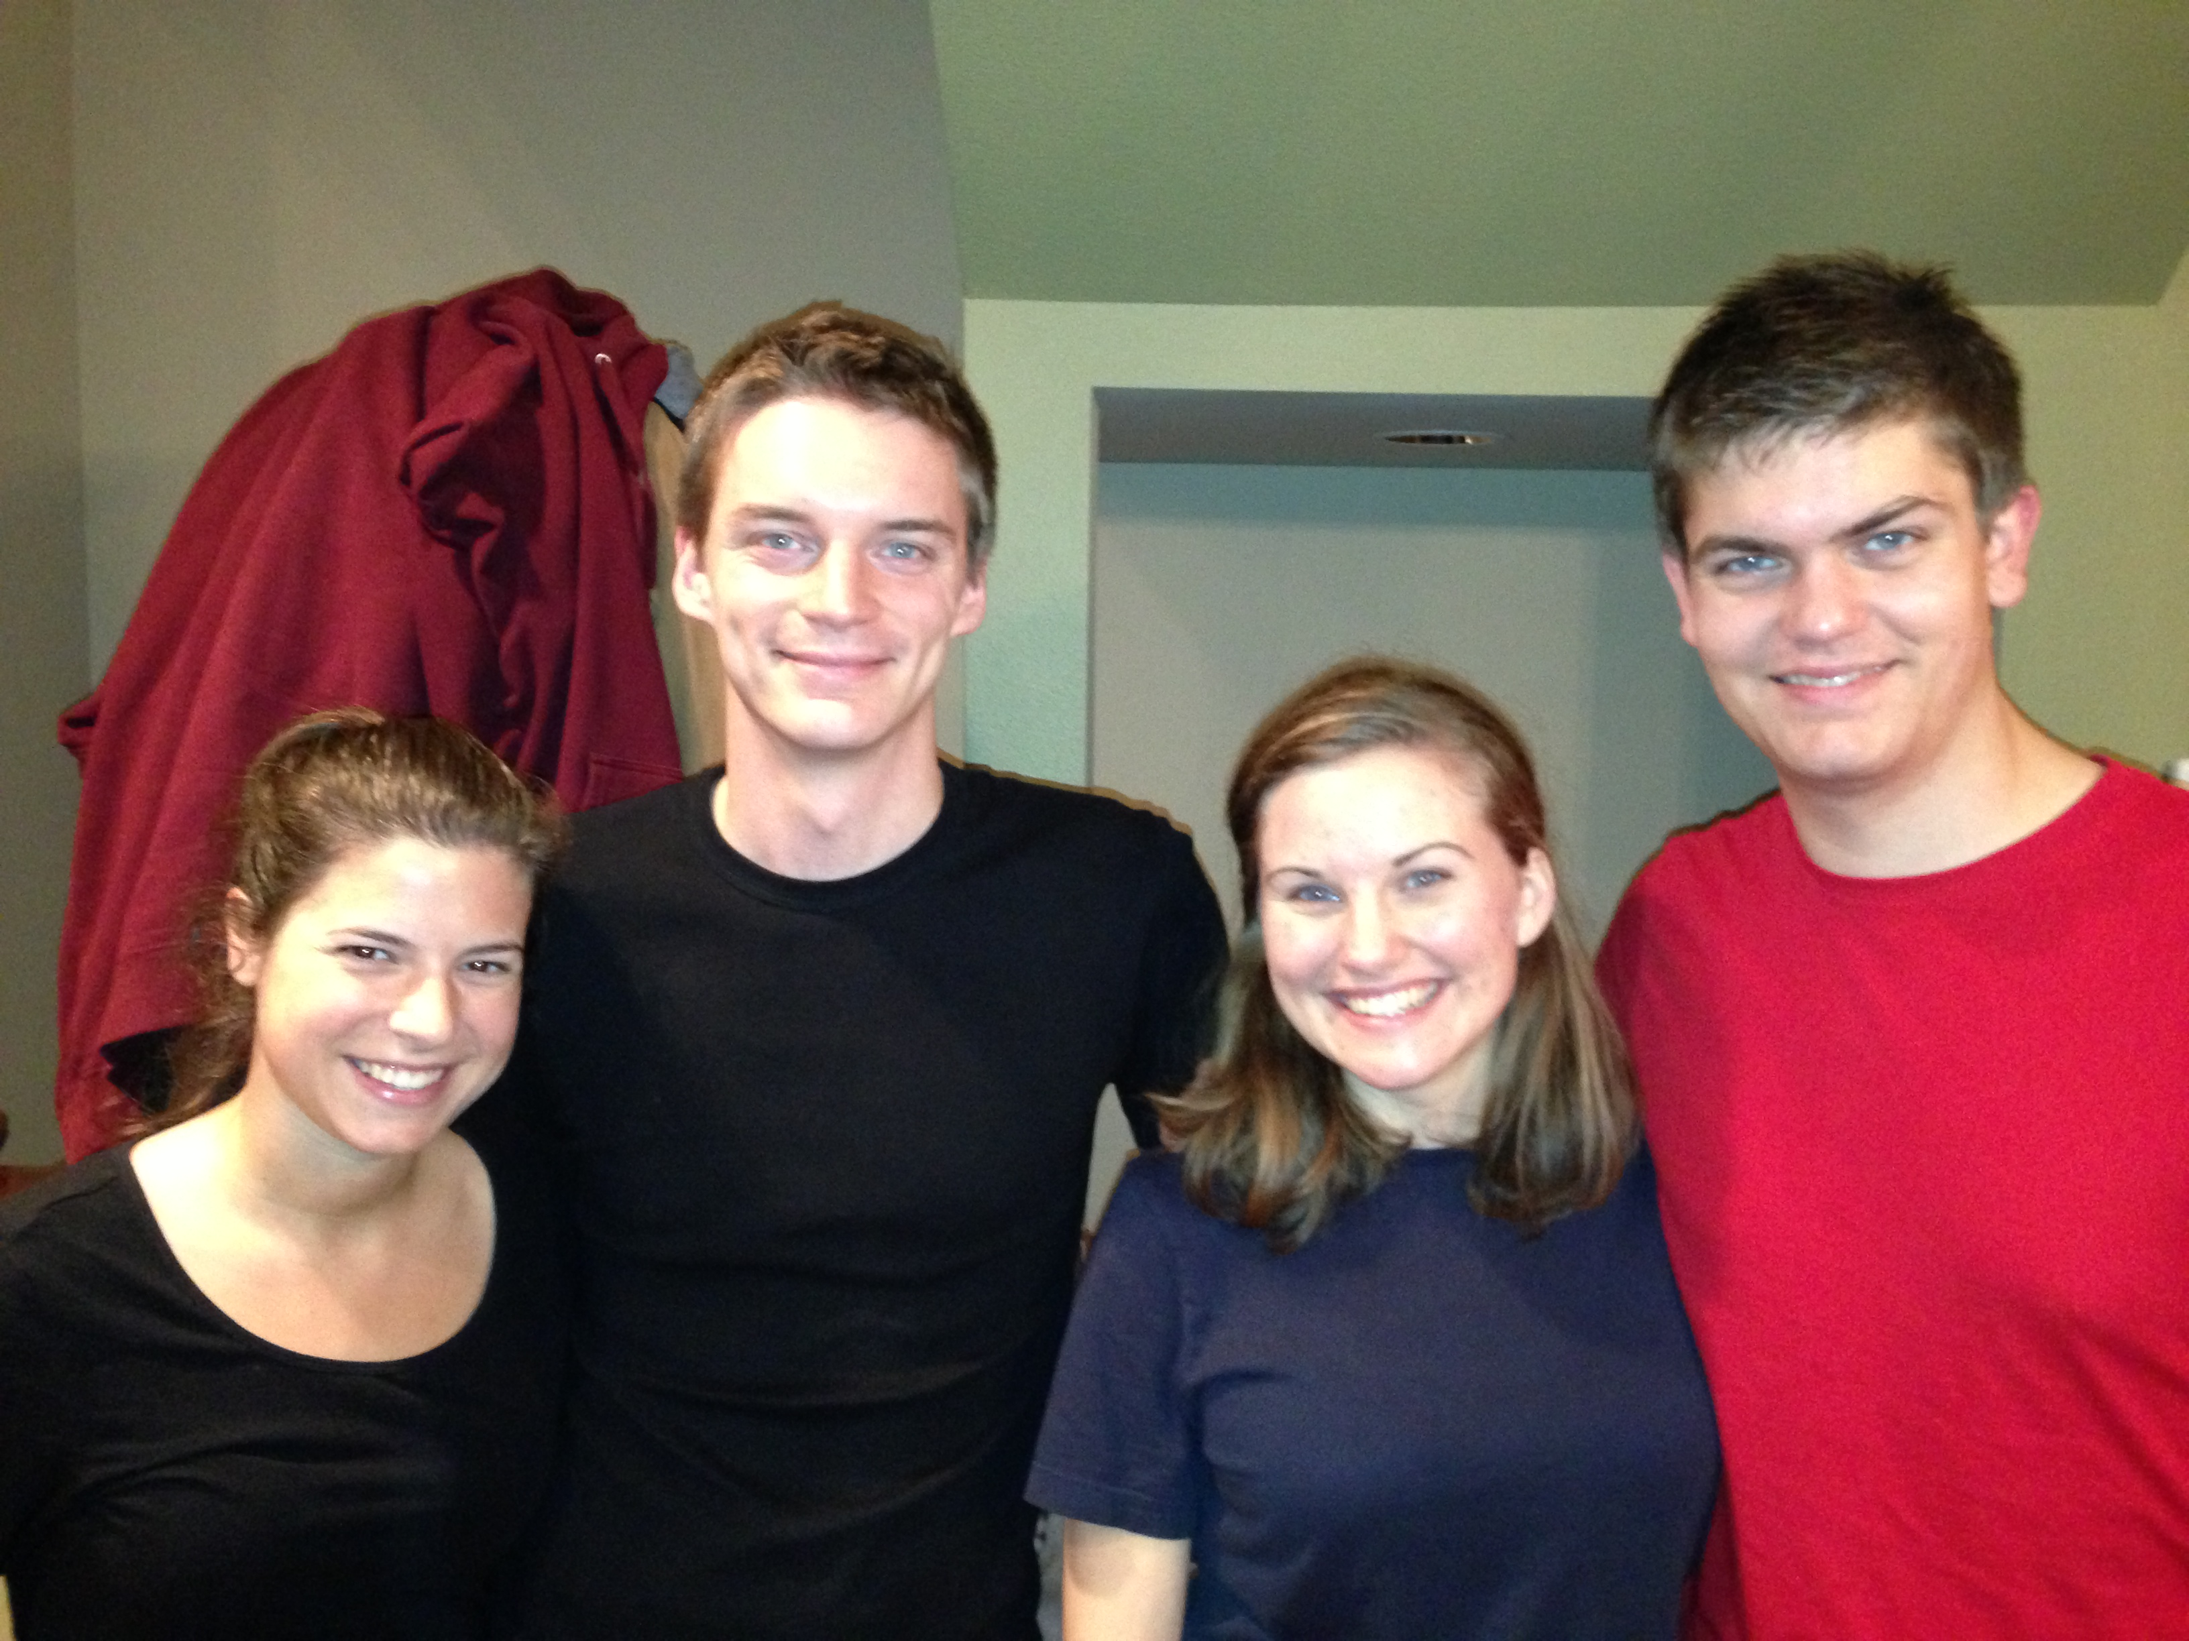
Cara & Kurt • Katie & Stephen

Slide 10
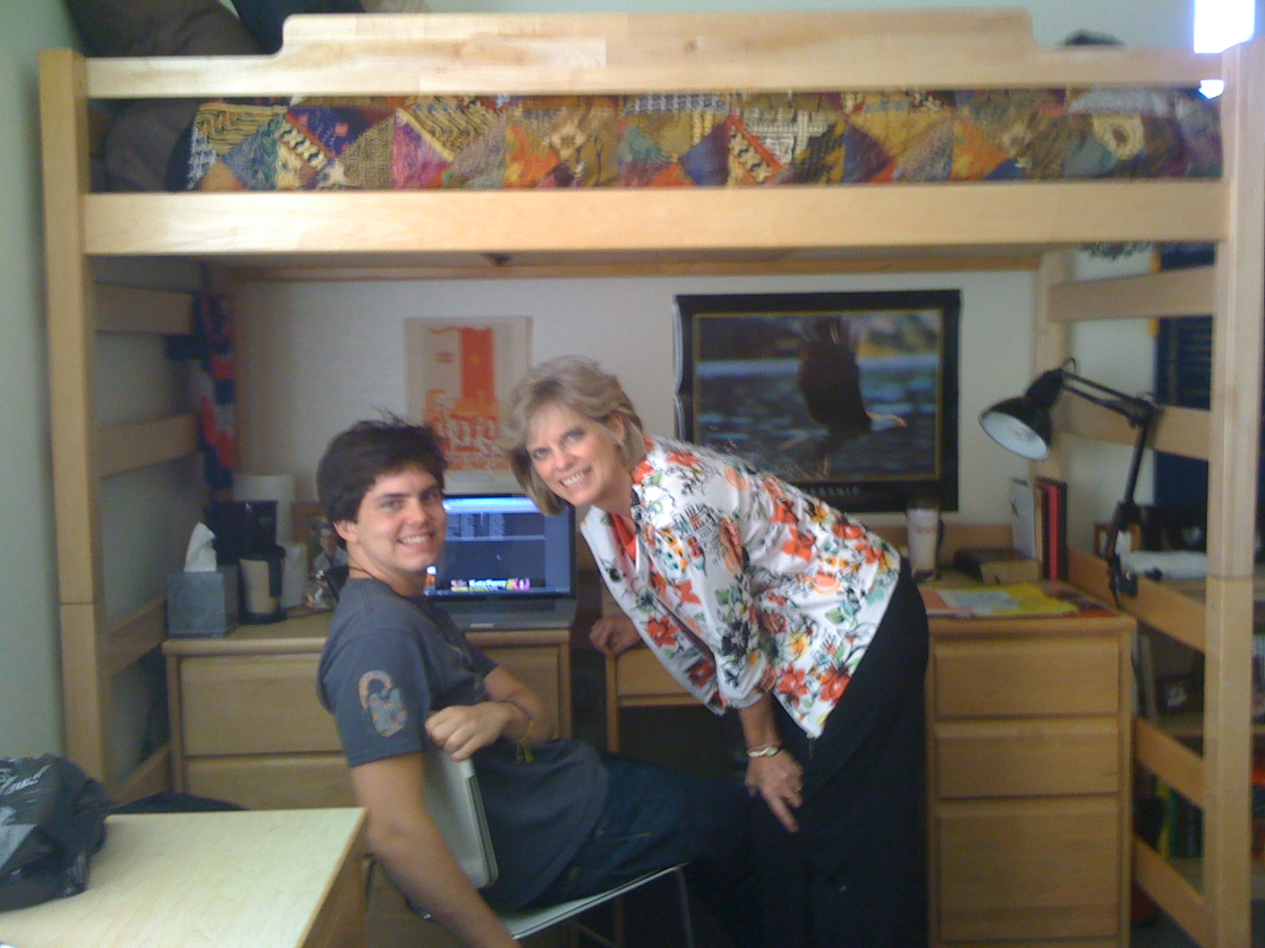
John at Biola University

Slide 11
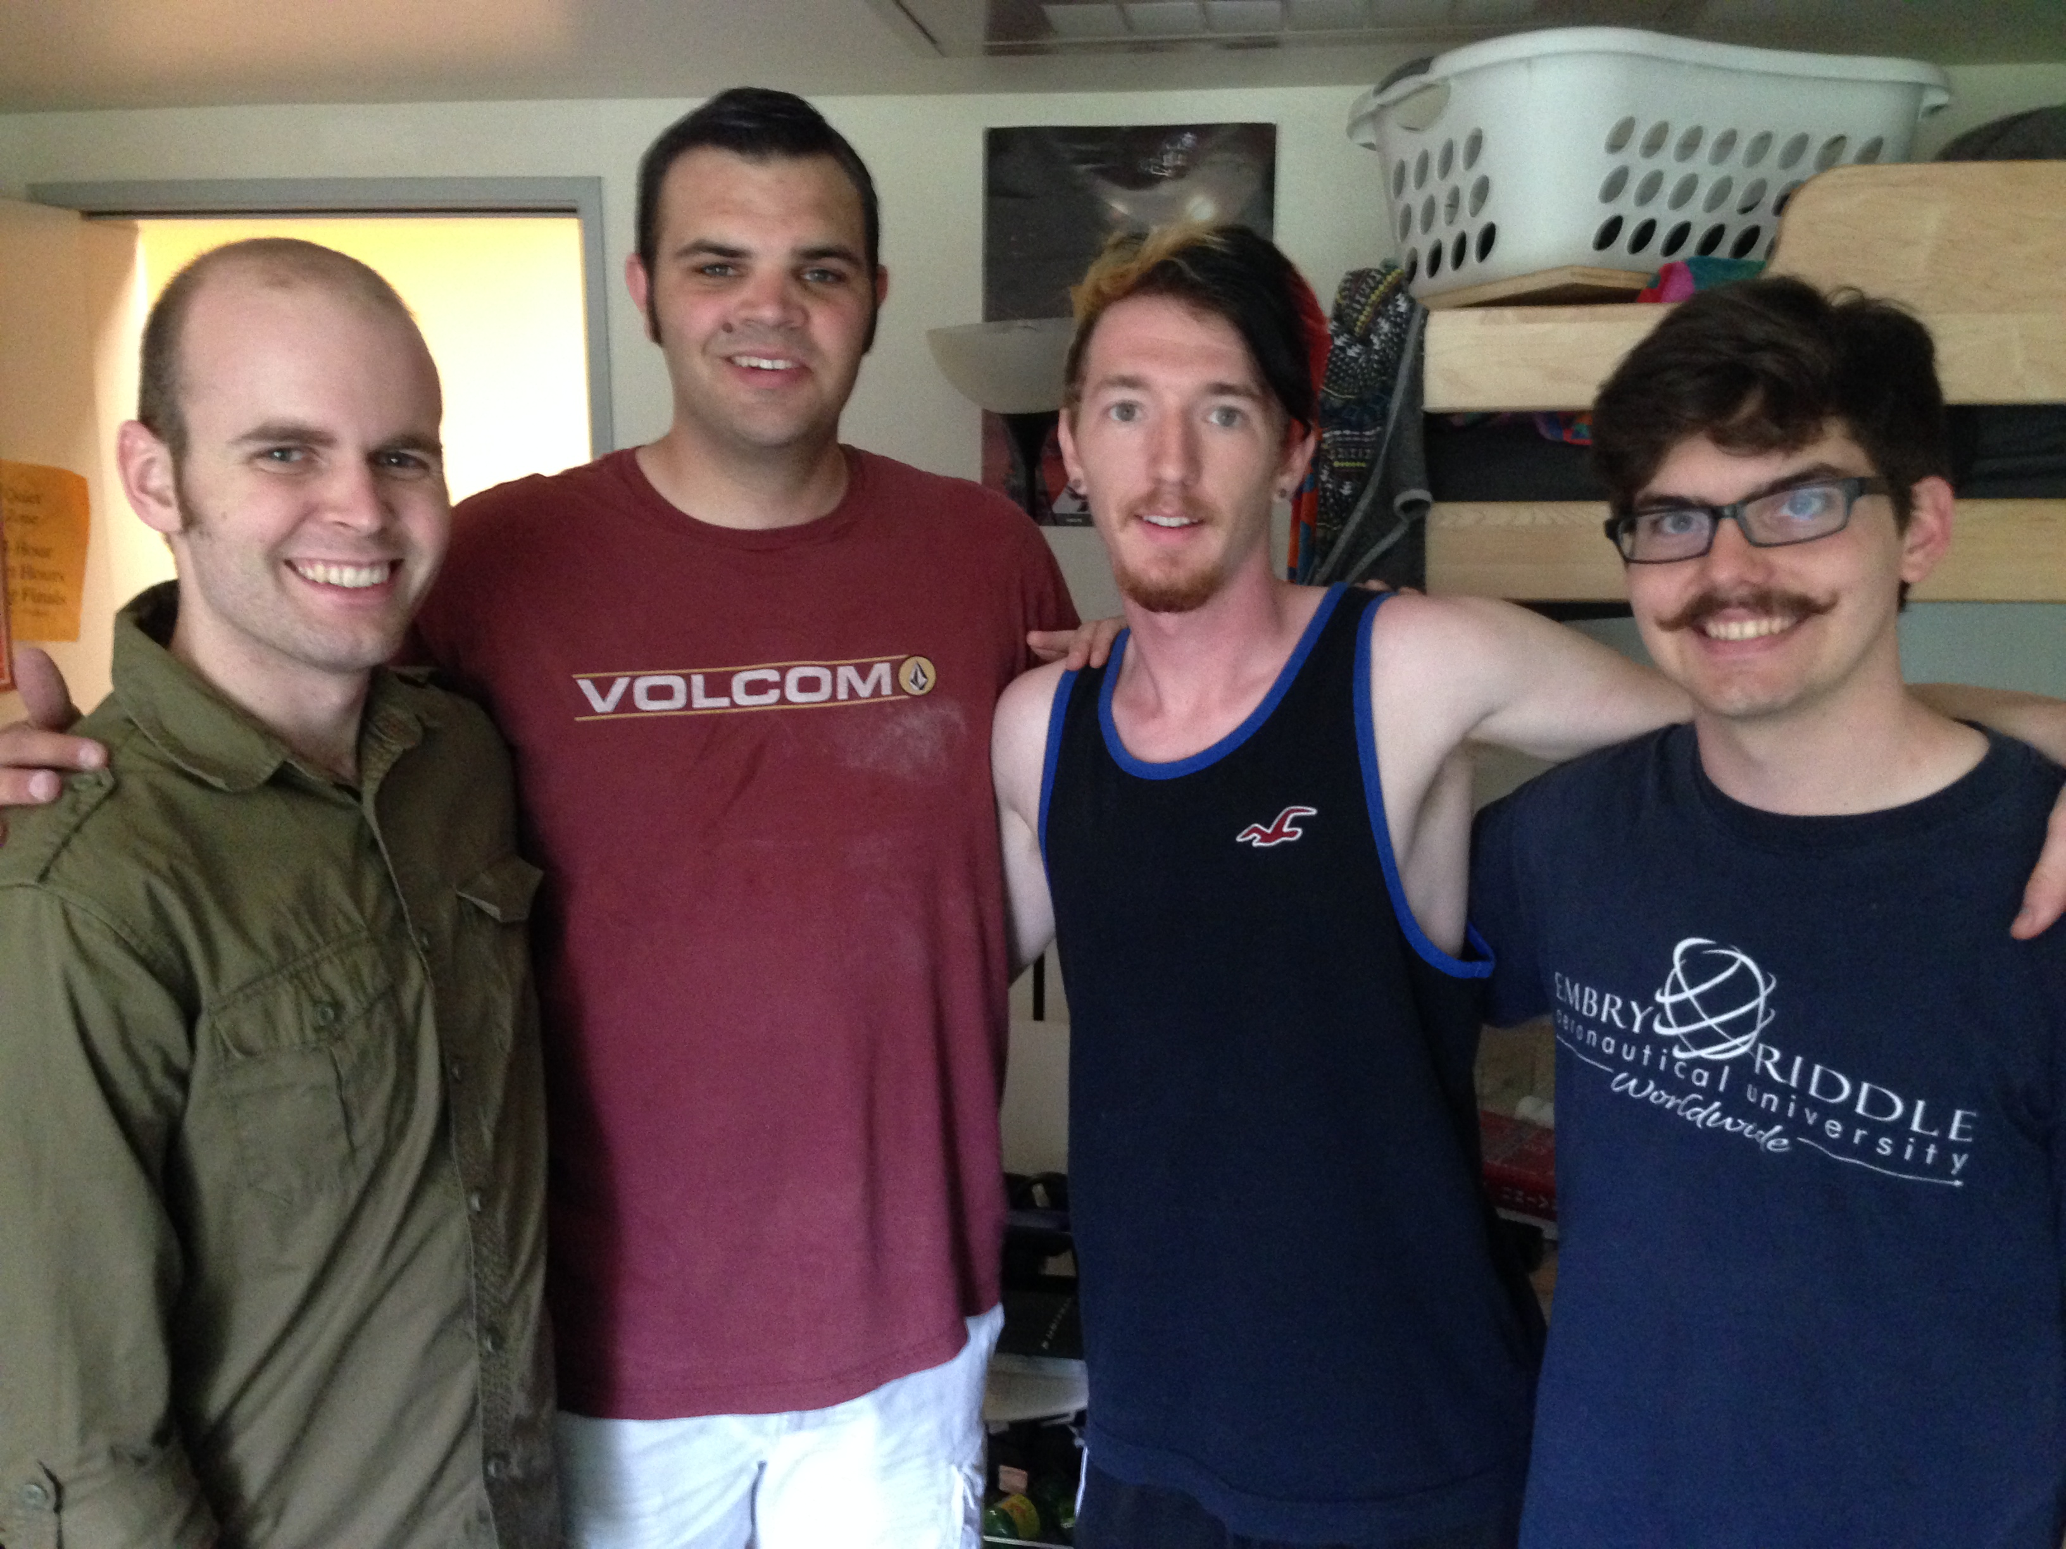
John is a graphic design major at Biola University in California

Slide 12
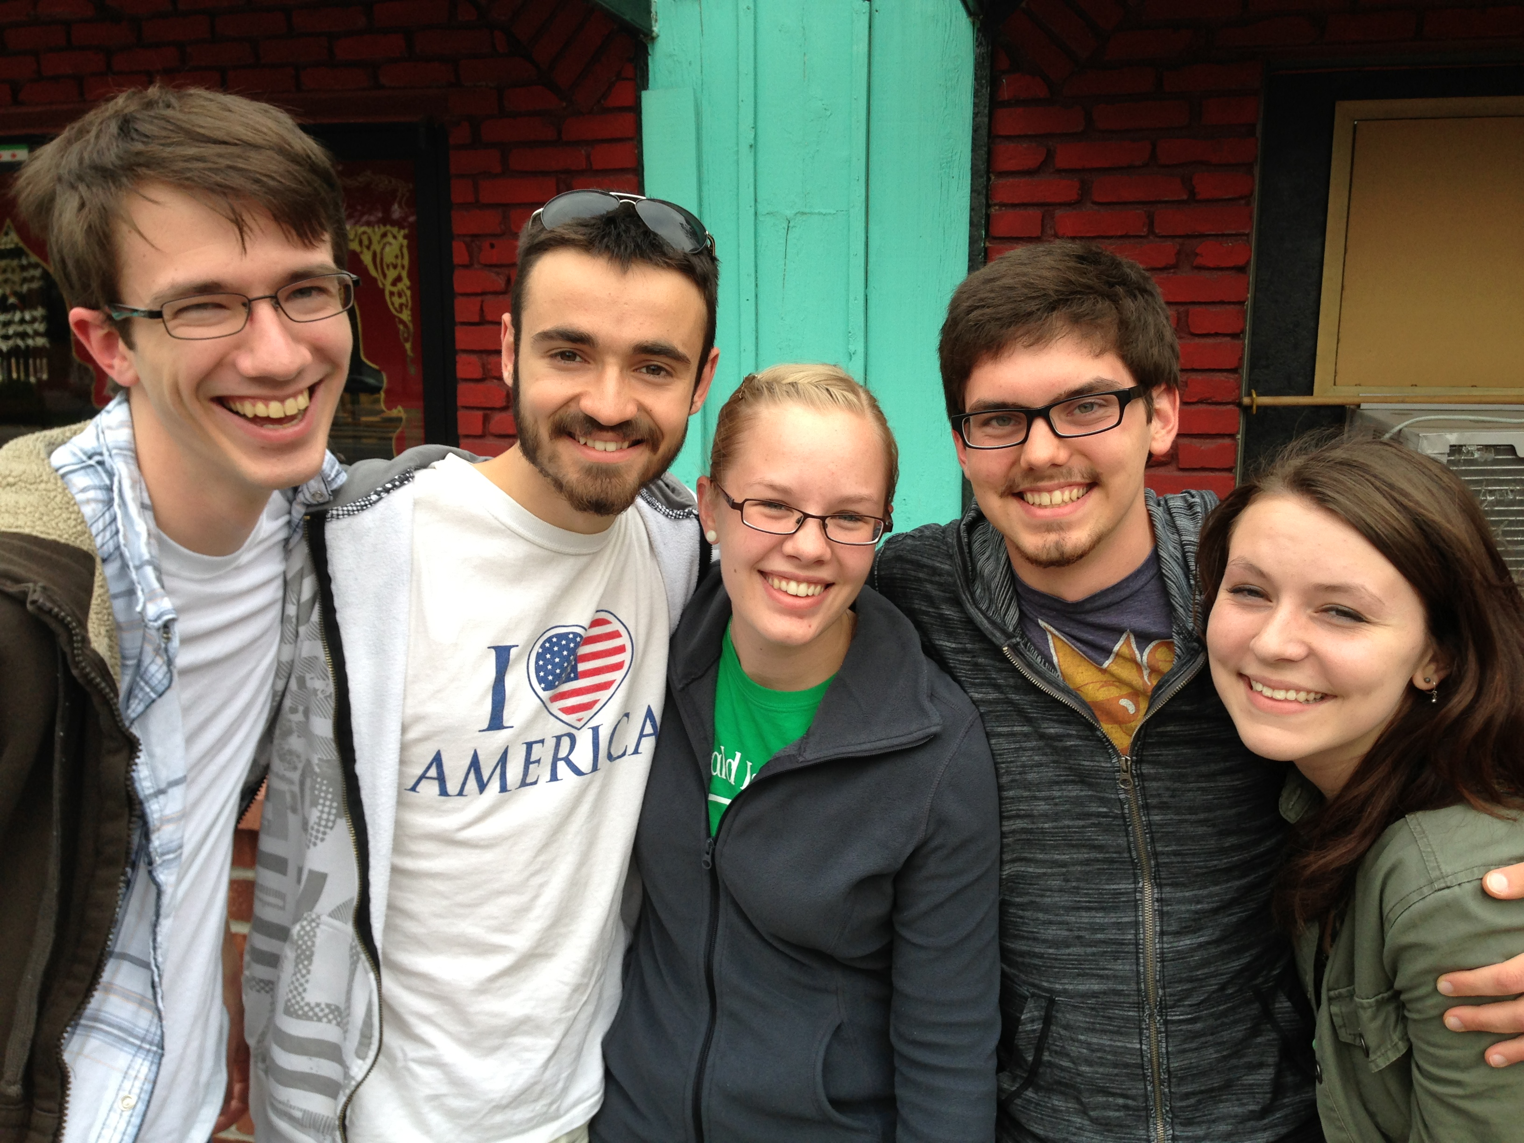
Caleb • Brennen • Holly • John • Kelsey
Taiwan • Slovania • Turkey • Singapore • Indonesia
WorldVenture Interns June- August 2013

Slide 13
Our Mission Organization…
7

Slide 14
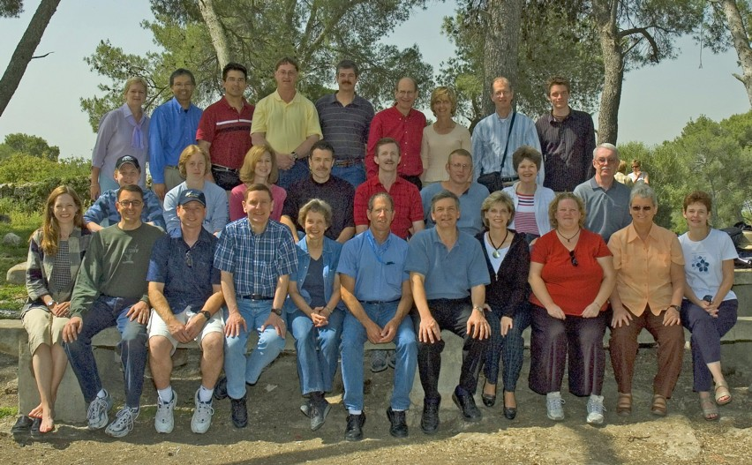
WorldVenture Seminary Professors in Israel
7

Slide 15
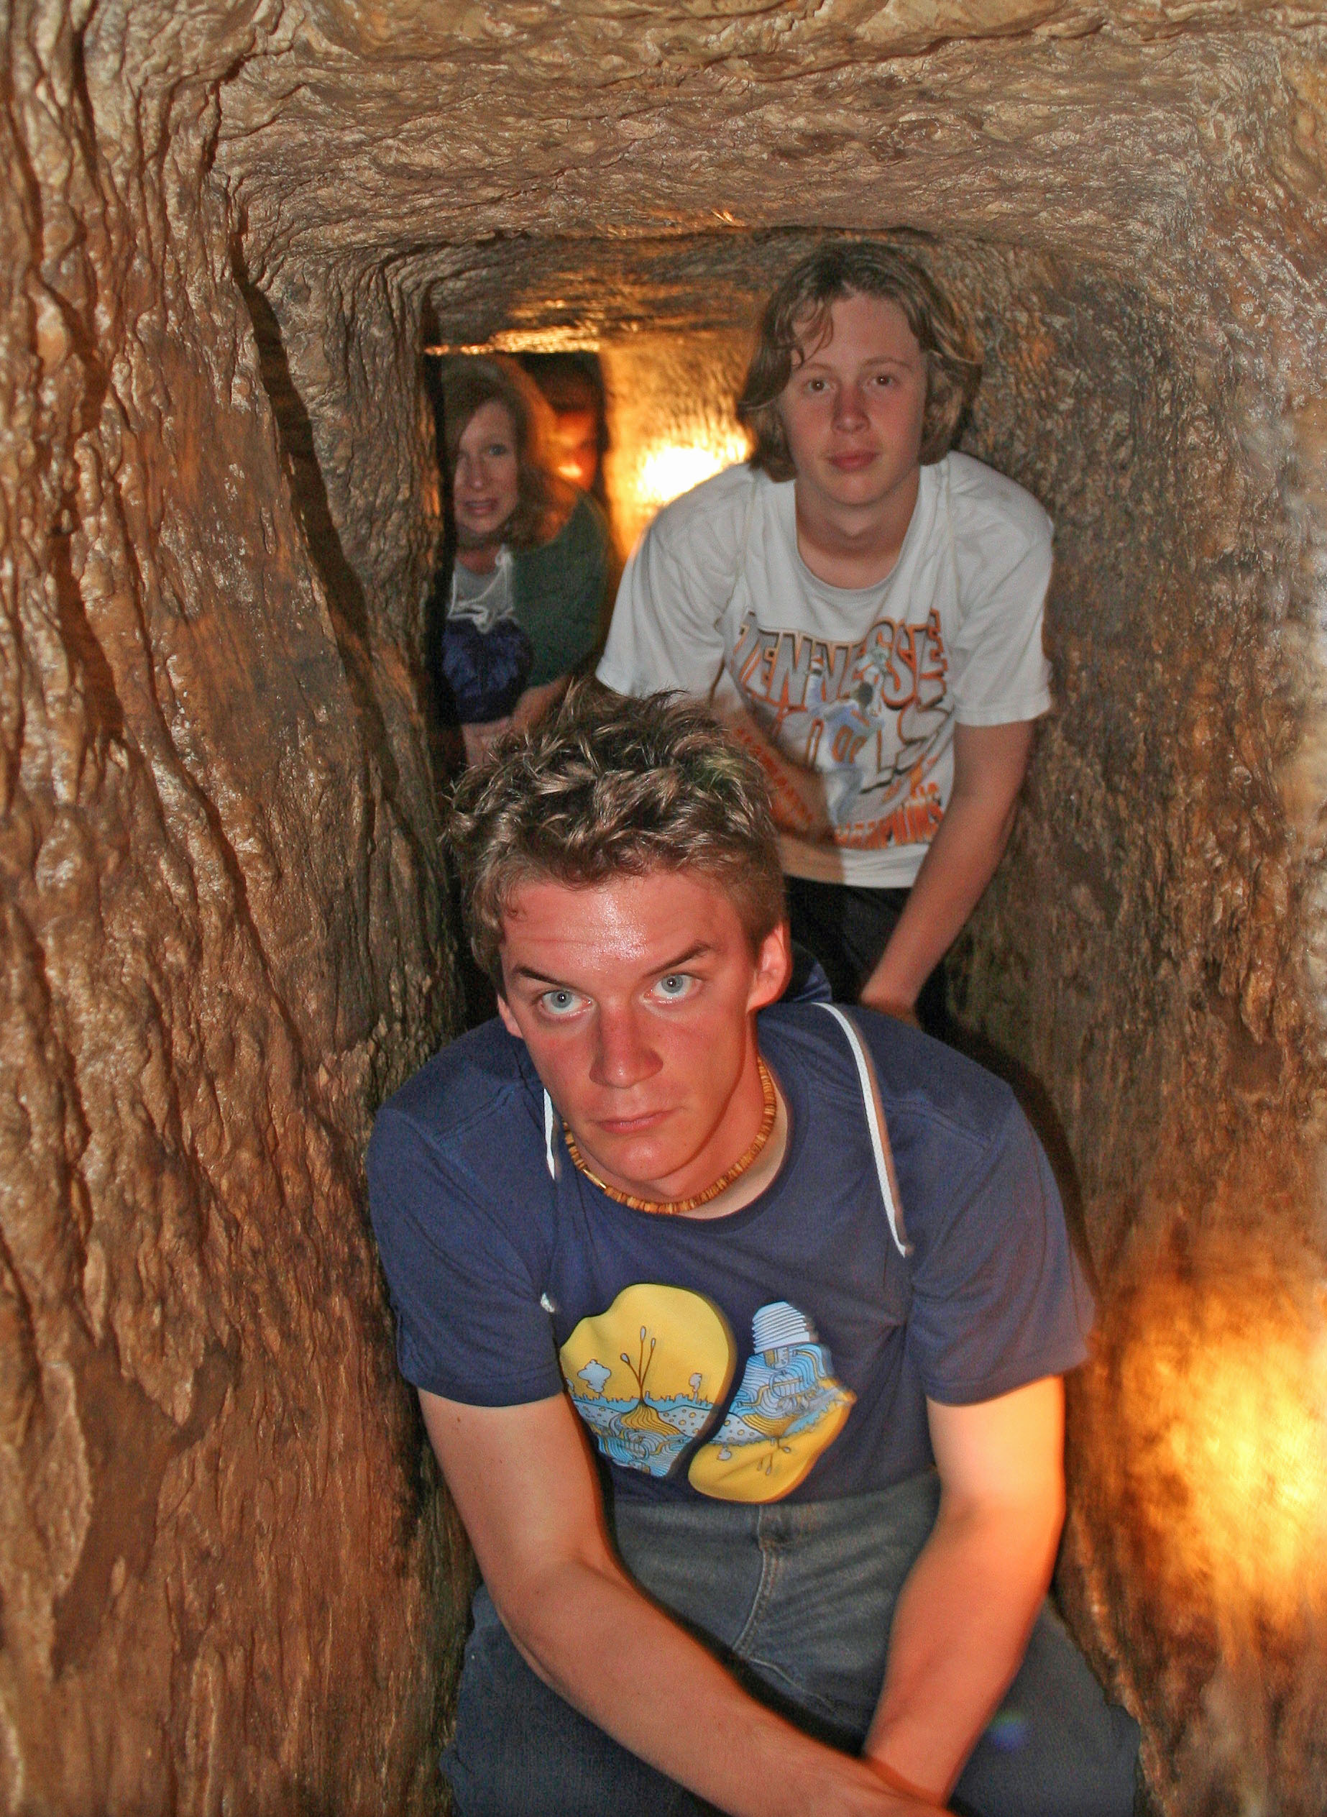
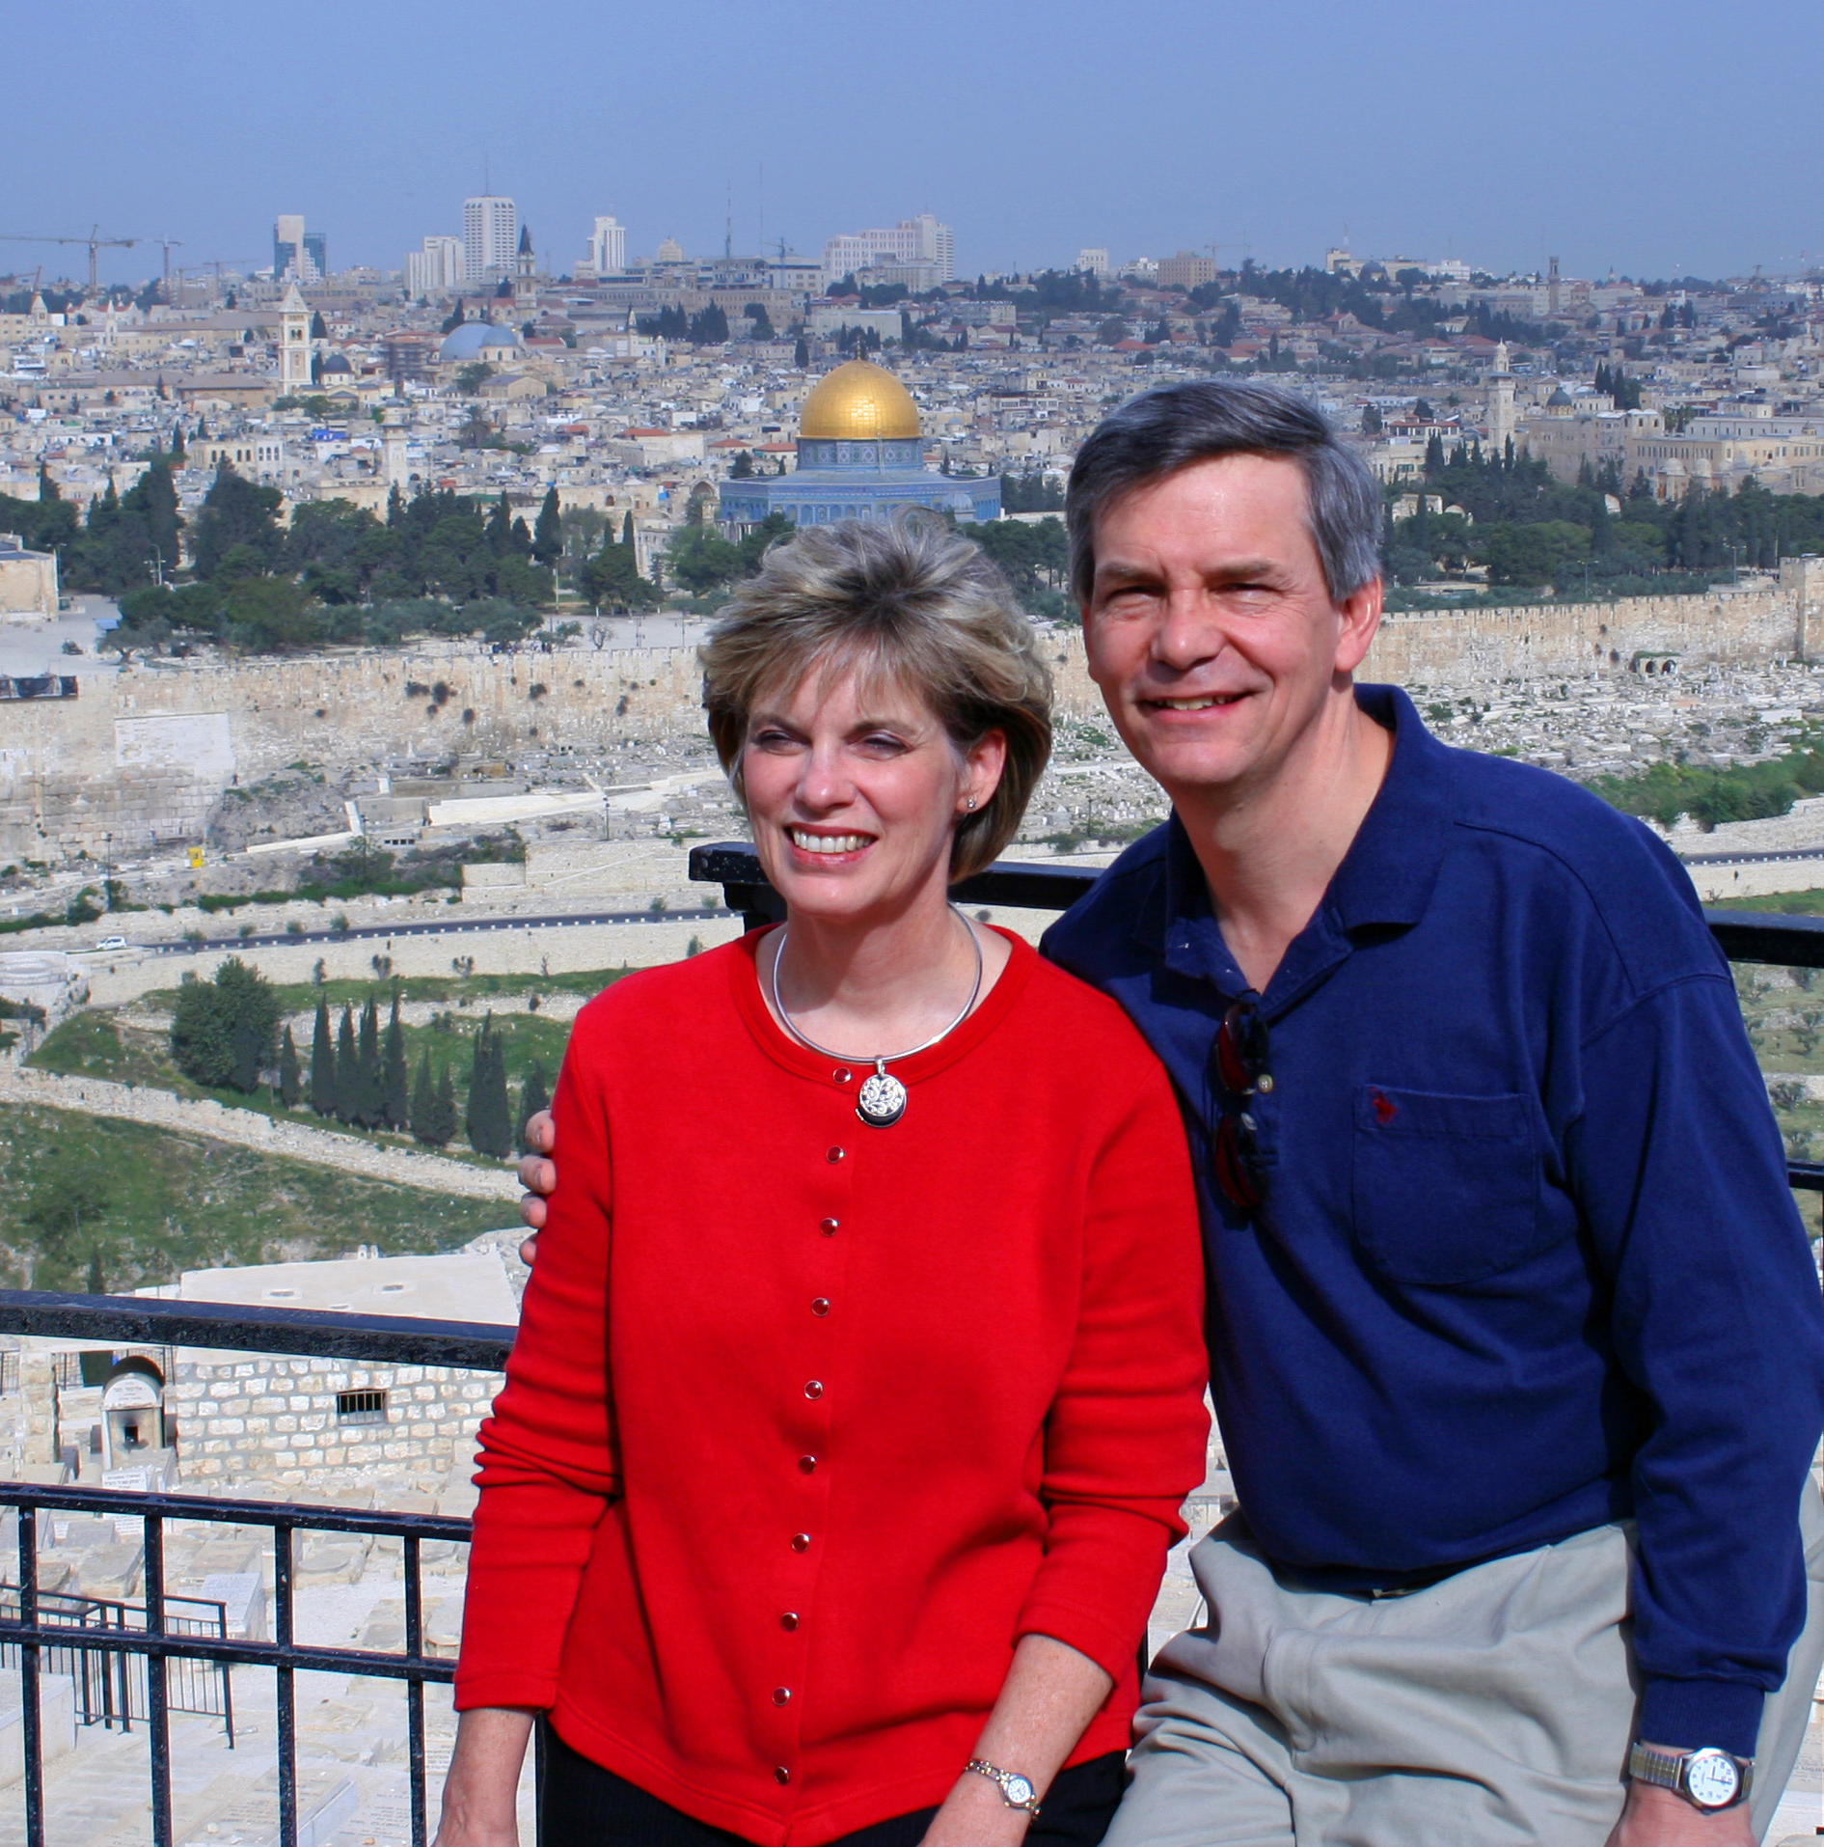
Susan & Rick at Mount of Olives
7
Kurt in Hezekiah's Tunnel

Slide 16
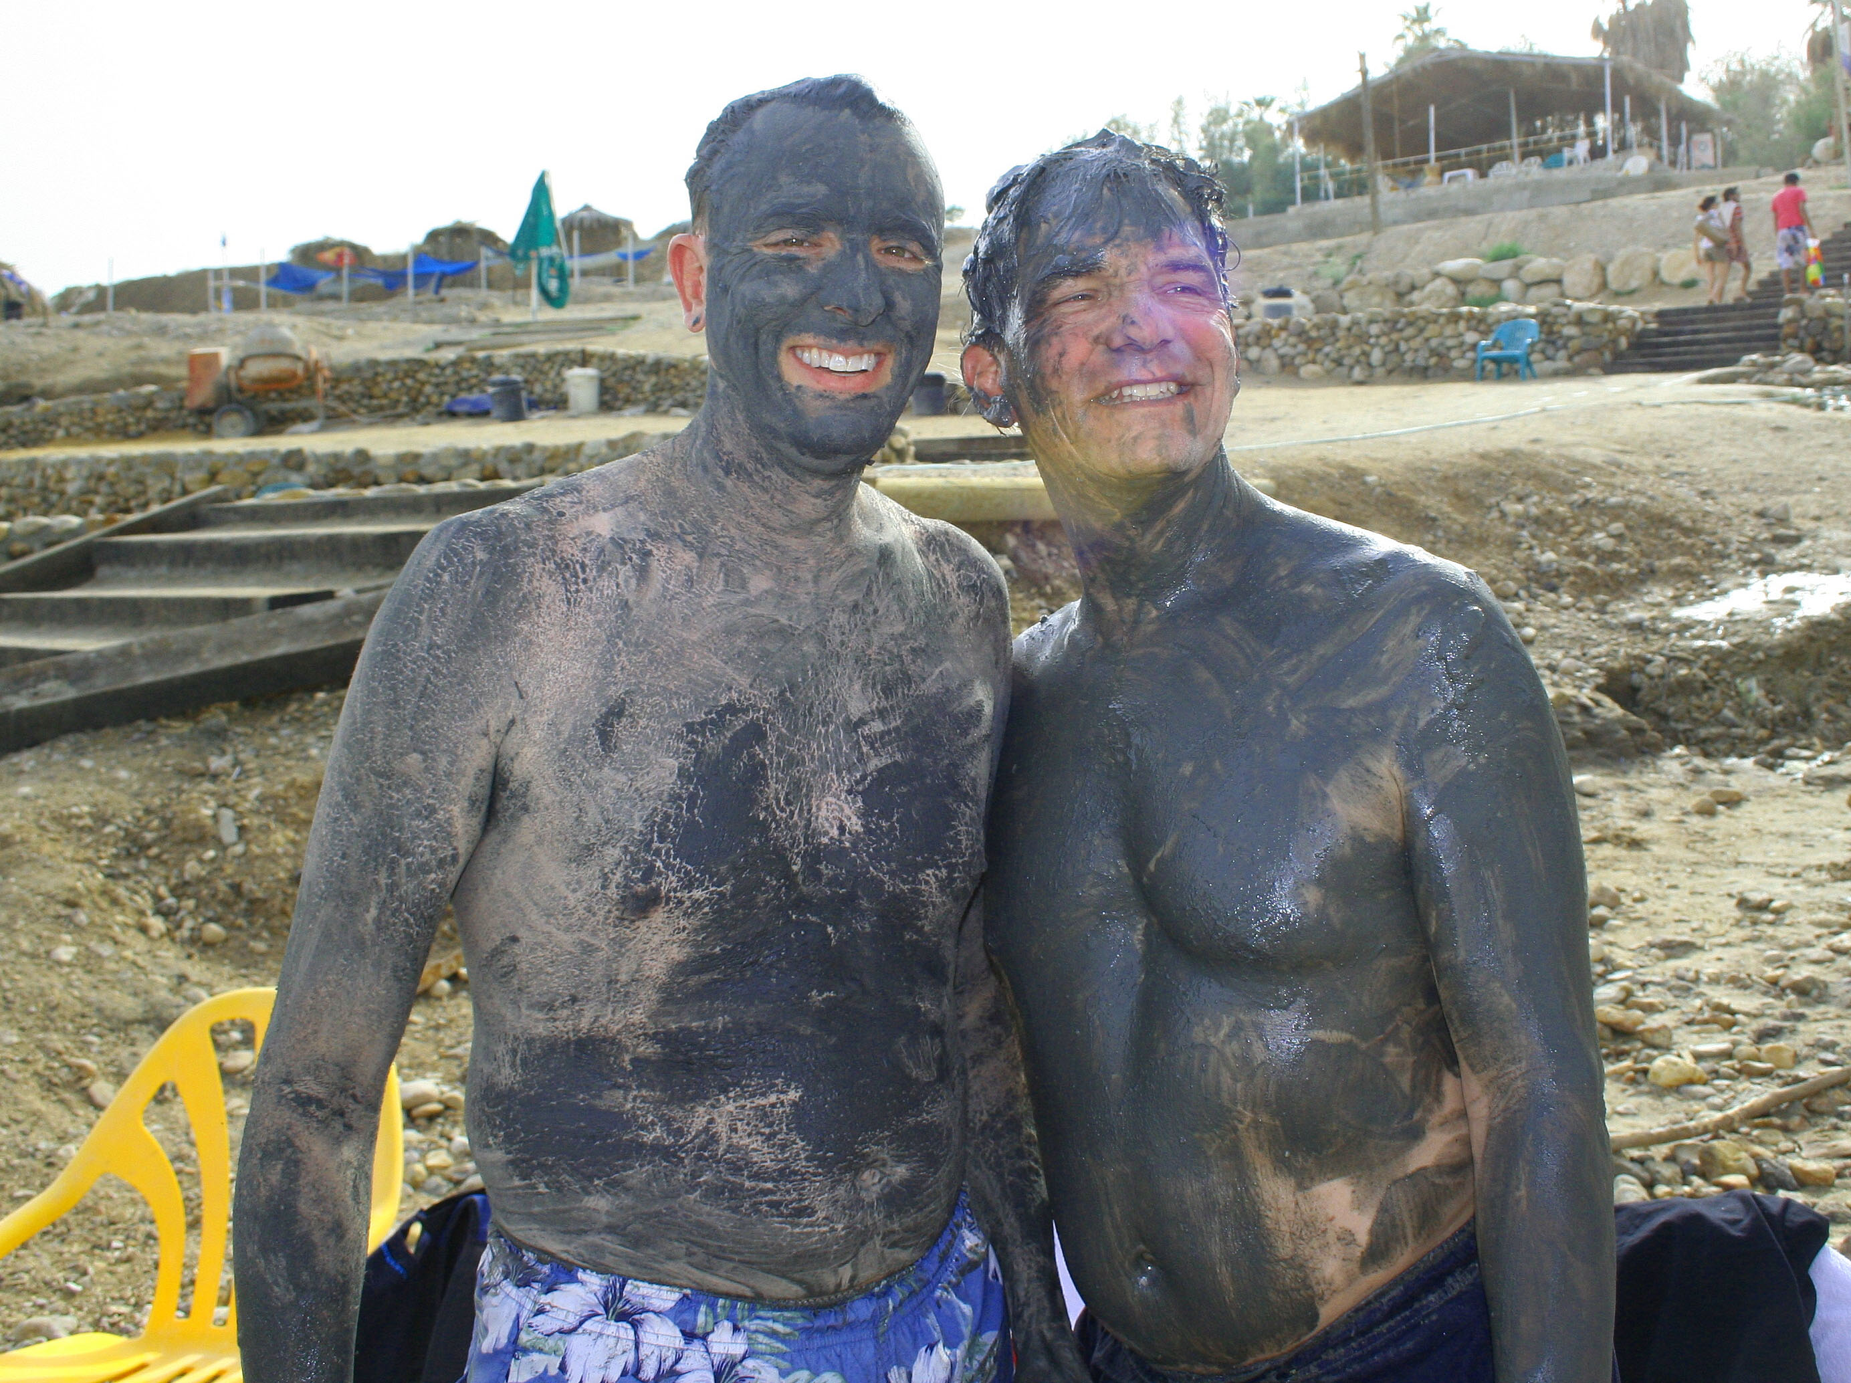
Dead Sea Mud
7

Slide 17
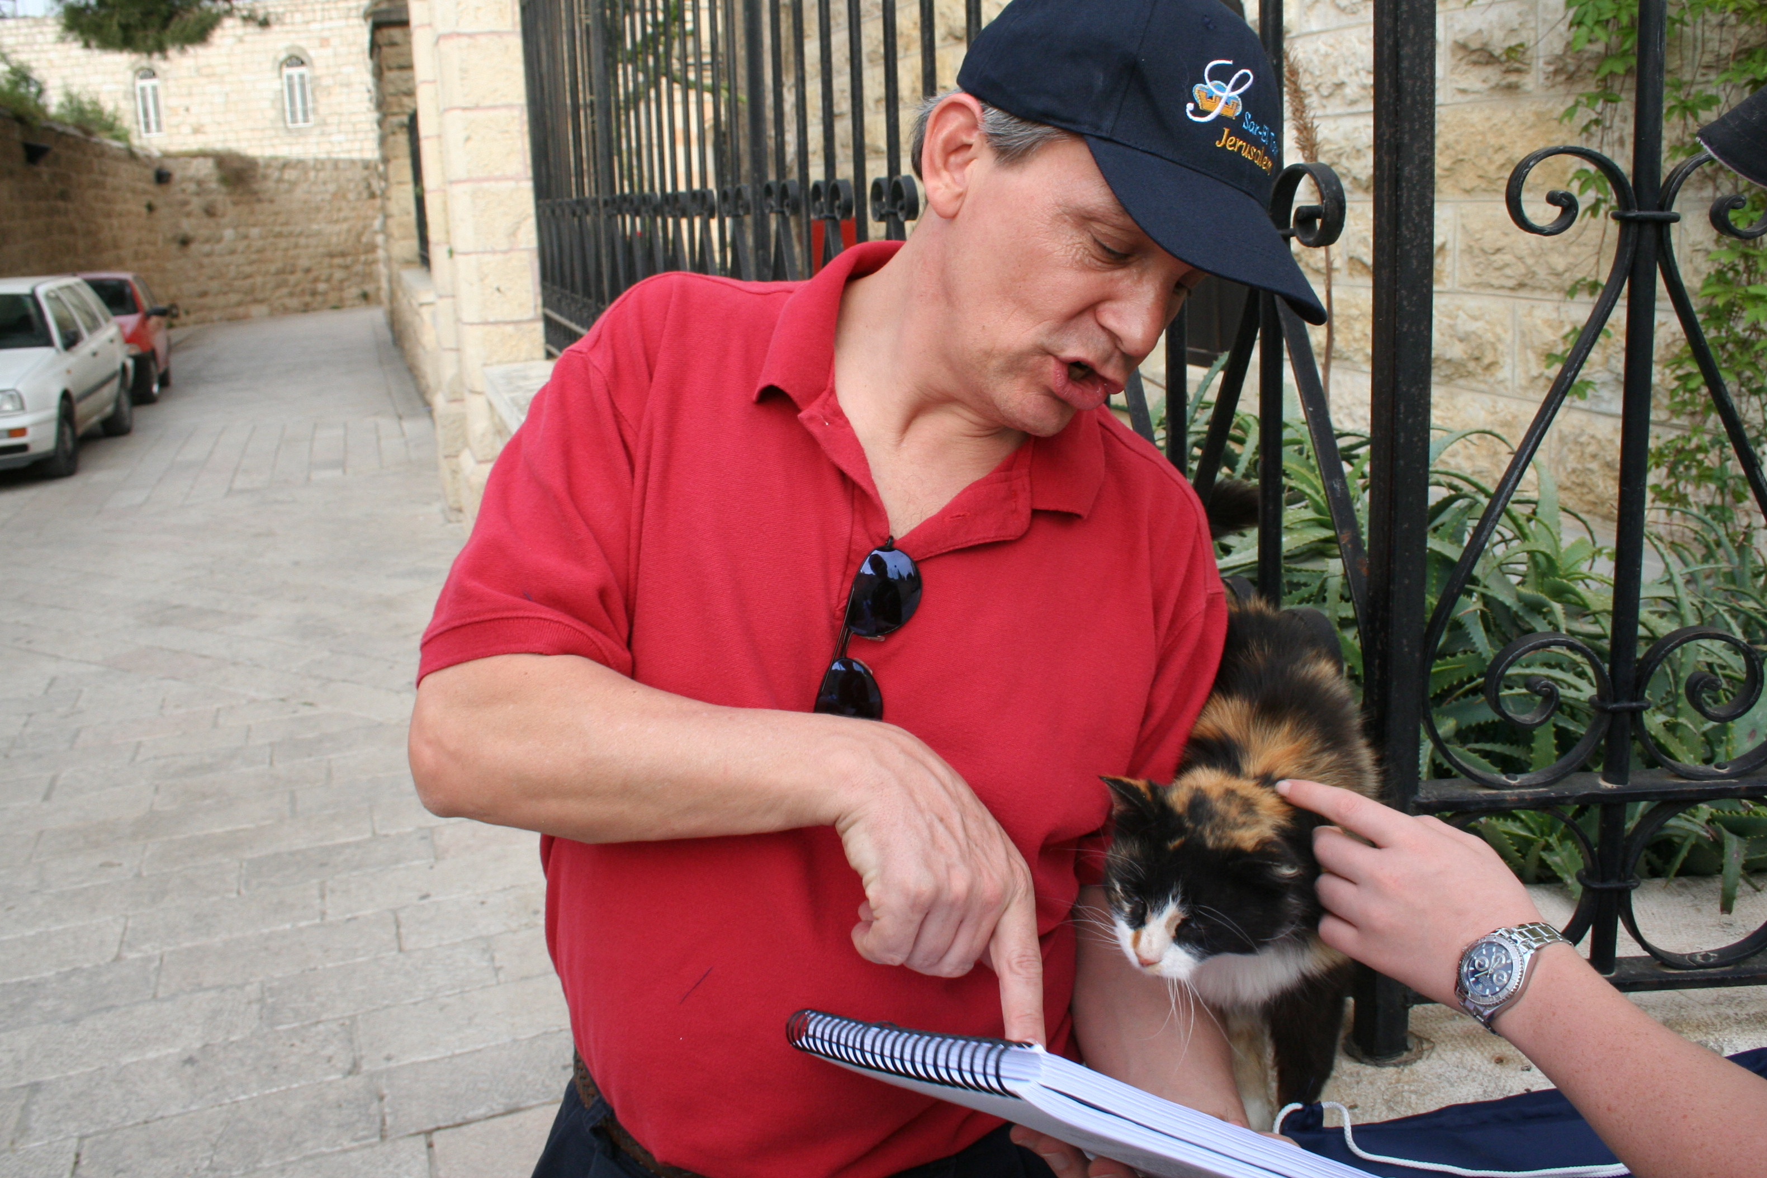
"Preach to every creature" (Mark 16:15)
7

Slide 18
English
7

Slide 19
Bahasa Indonesia
7
Presentasi dari The Bible…Basically Ministries International Inc. Fort Worth, Texas
www.biblebasically.com
7.5.01.
©2003 TBBMI
04

Slide 20
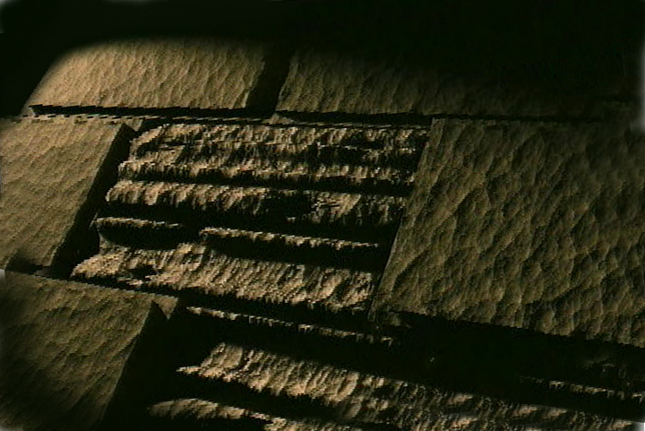
Chinese (Mandarin)
7
圣经...
基要
国际基本事工呈献…圣经纵览系列. 福特沃得, 德州
www.biblebasically.com
8.0.01.
©2003 TBBMI
04

Slide 21
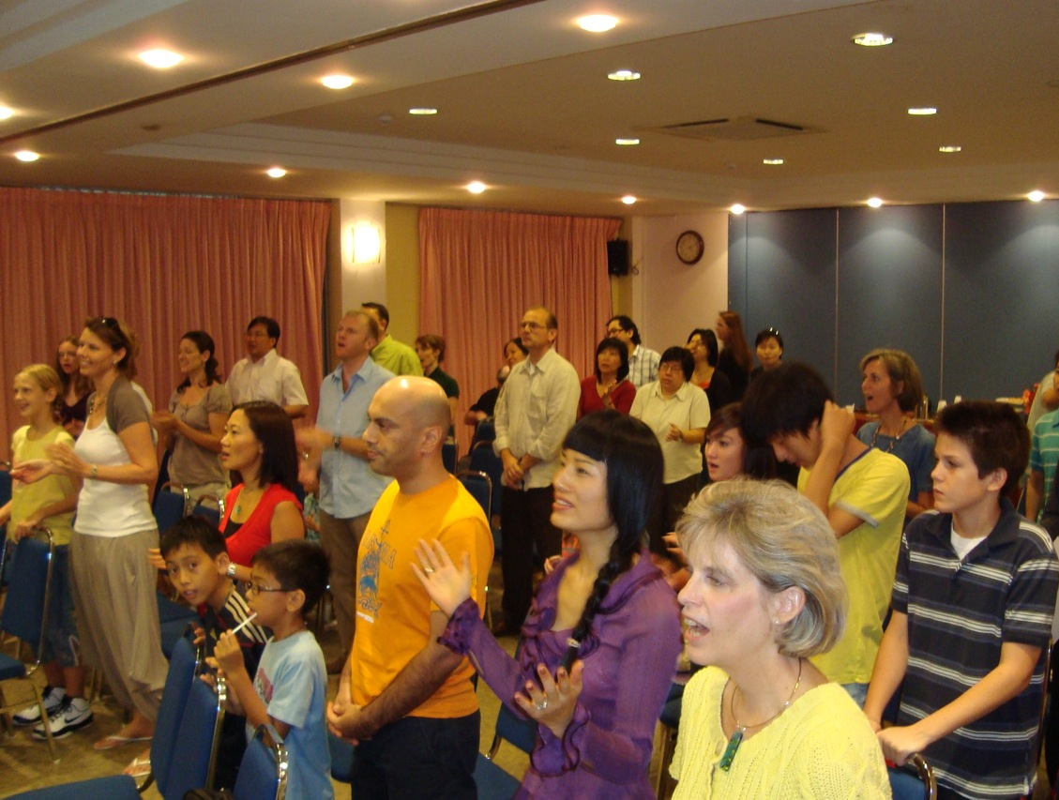
Our People
7
35 people from 10 nations

Slide 22
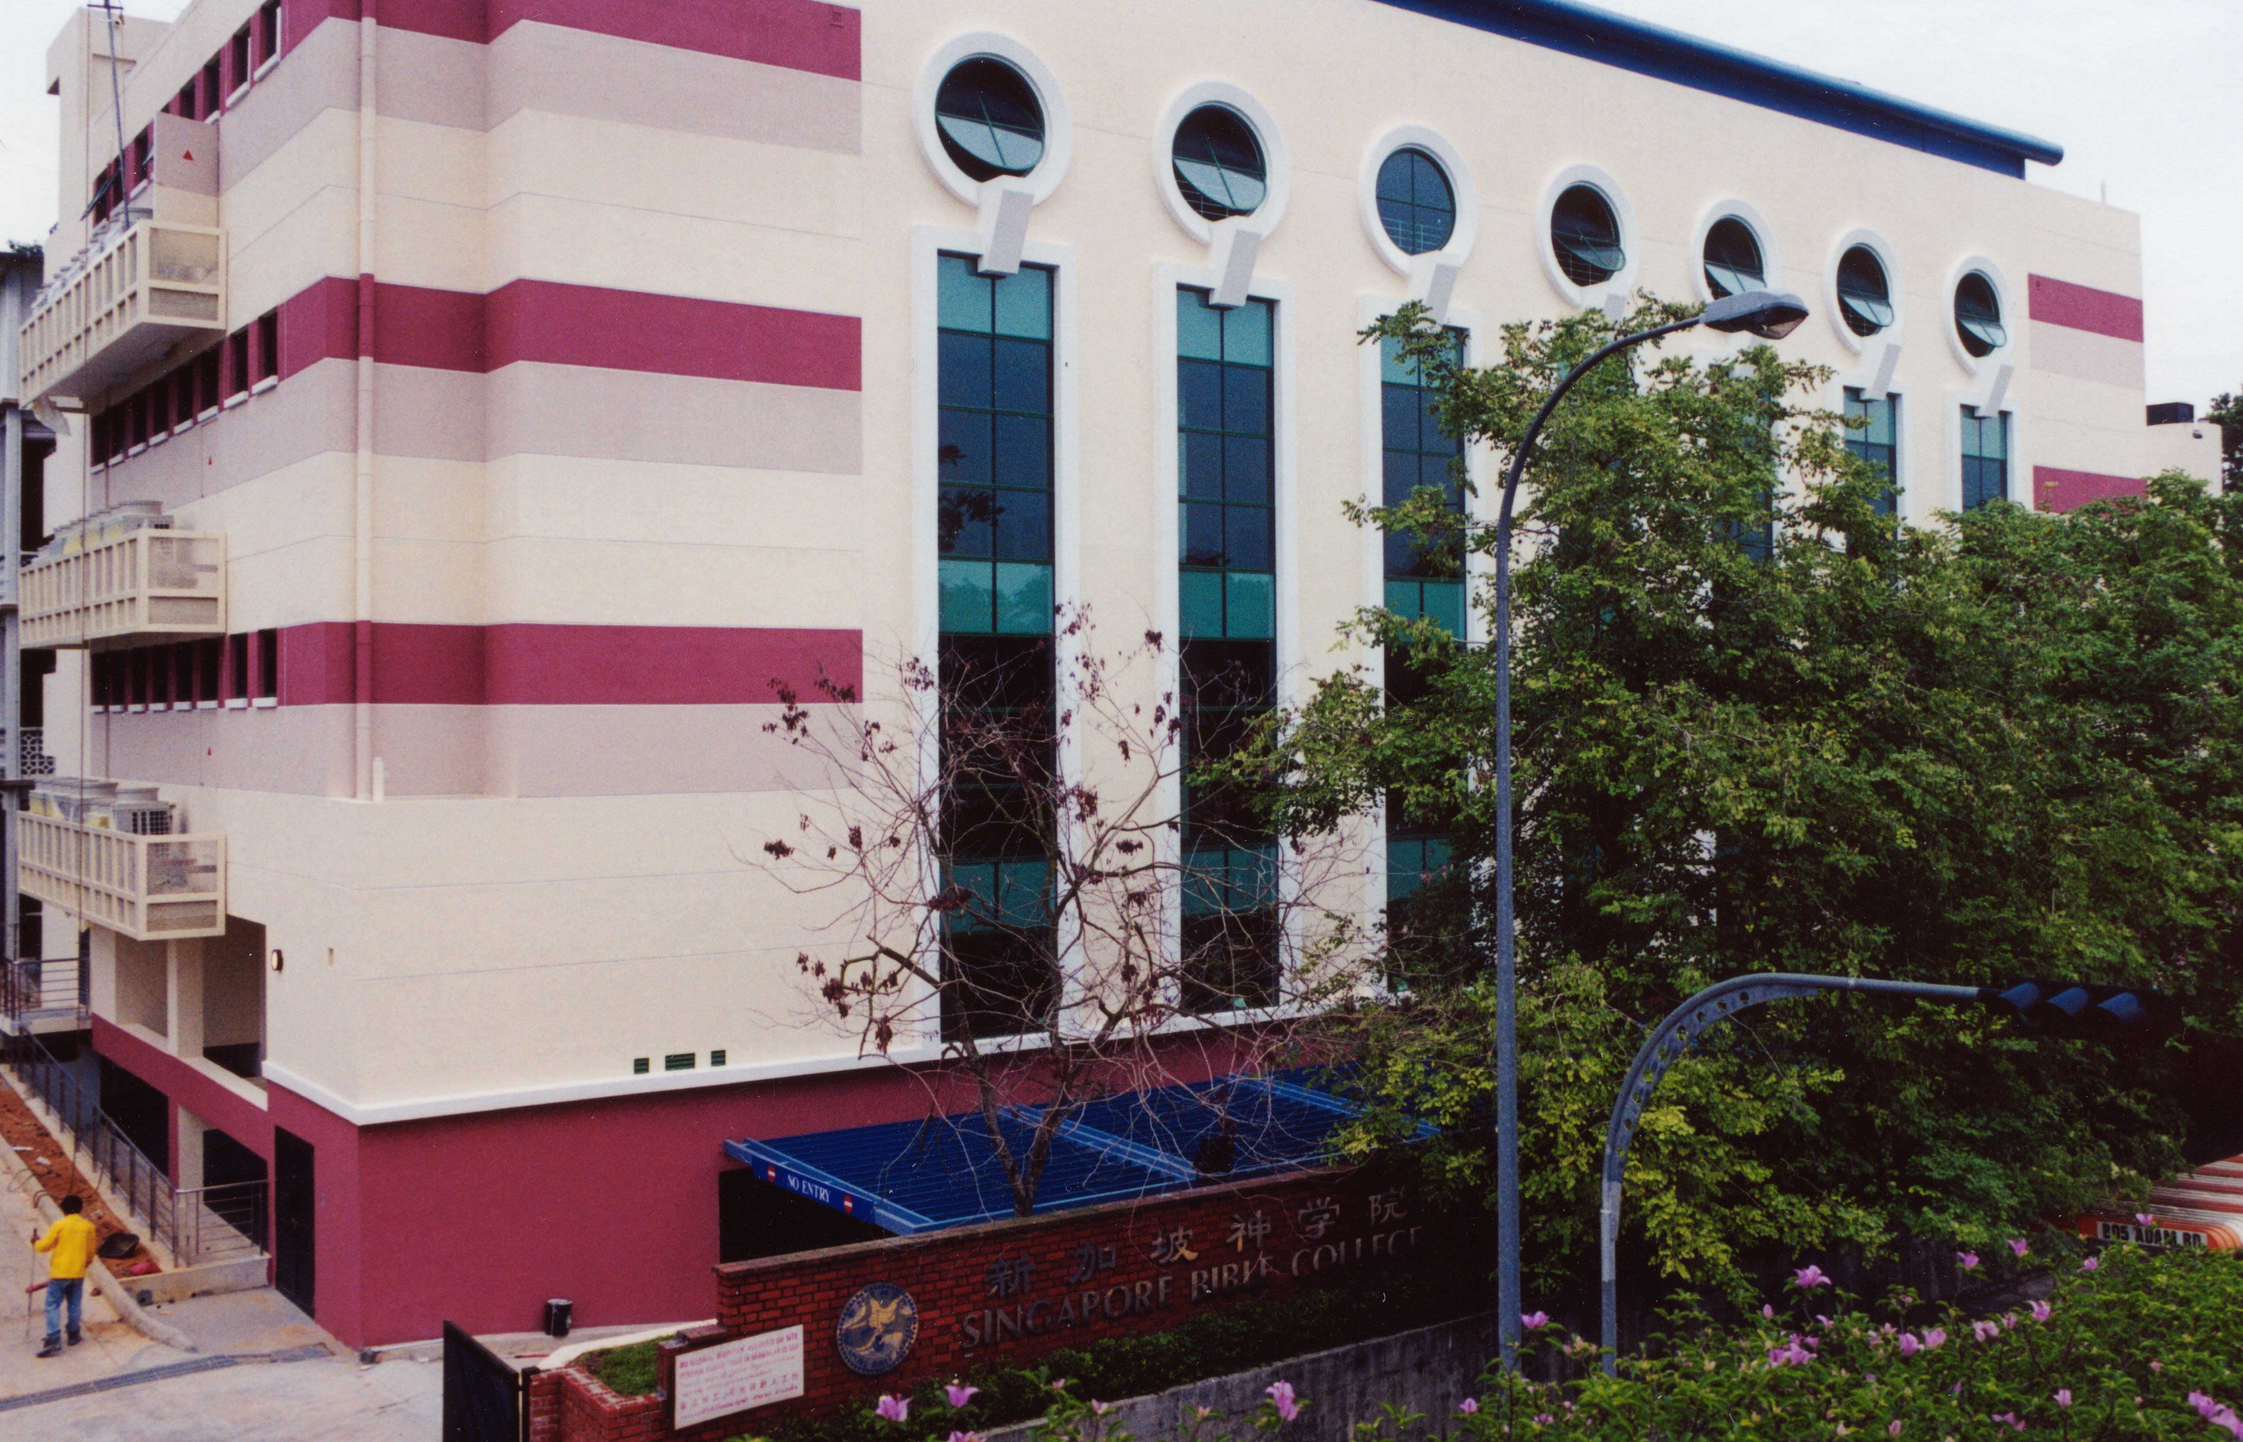
SINGAPORE BIBLE COLLEGE
7
Notes:
I've served as a seminary professor with 30 other faculty at Singapore's largest training school: Singapore Bible College

Slide 23
SBC Courses I Teach
7
(English • Bahasa • Chinese)
Survey
OT NT
Backgrounds
WOT WNT
Theology
Church Spirit Future
Preaching
Homiletics 1 Homiletics 2
Notes:
I get to teach these leaders every book of the Bible in survey courses, plus backgrounds to both the OT and NT, three areas of theology, and how to preach.

Slide 24
biblestudydownloads.com
7
Notes:
Student translations have resulted in Bible teaching and study materials—mostly PowerPoint—in 40 languages! All a teacher needs to do is to click on a file and it downloads for free to teach any book of the Bible and many other subjects.

Slide 25
Ministries God Gave Us
7
WorldVenture Singapore field leader
Singapore Bible College seminary professor
Biblical Education by Extension traveling teacher
The Bible…Basically translation director
International Community School board member
Crossroads International Church pastor-teacher
Internet Biblical Seminary course writer

Slide 26
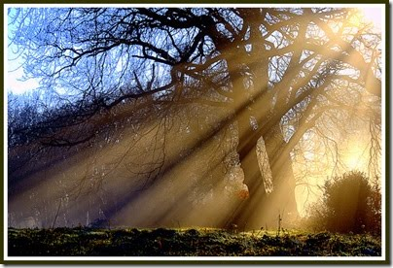
Purpose
1
Few of us read a book through and then neglect to read the last chapter. However, many Christians do that with the Bible. They avoid reading the book of Revelation due to its strange visions and symbols. Ironically, the word "revelation" means "unveiling" and yet this book remains the most veiled of them all.
This course will help you see the chronological arrangement of this prophecy so you can interpret its message correctly.

Slide 27
Purpose
1
The focus of the book is the sovereignty and final victory of Jesus Christ, so our study will help develop your relationship with Him in all His glory.
The course is immensely important in your Bible college curriculum as it shows the end to which all of history points.

Slide 28
Course Objectives
1
By the end of the course the student should be able to…
Understand the background to Revelation in terms of authorship, occasion, recipients, date, unique characteristics, etc.
Critique the four major interpretive approaches to the book of Revelation to properly understand prophetic literature.

Slide 29
Course Objectives
1
By the end of the course the student should be able to…
Explain the key themes of the book: the sovereignty of Christ in future victory, addressing external persecution and internal compromise in the church in light of the glorified Christ, the justice and mercy of God, and worship in view of history's consummation.
Trace the basic three-fold outline of the book with its climax in the return of Christ (Rev. 19).

Slide 30
Course Objectives
1
By the end of the course the student should be able to…
Apply the strengths and weaknesses of the seven churches of Revelation 2–3.
Understand the basic flow of the judgments in the Tribulation Period (seals, trumpets, and bowls, with supplementary data).
Show how the Tribulation and Millennium fit into the plan and purpose of God.

Slide 31
Course Objectives
1
By the end of the course the student should be able to…
Defend the premillennial perspective of Revelation 20:1-6.
Feel awe at the glory of heaven and the privilege of heaven as our future home!
Make any needed changes in his or her life to appear before Him unashamedly

Slide 32
Course Requirements
2
200 points
Reading (40) Wiersbe (20) + Revelation (20)
Assessments (160) 4 Quizzes (80) + Final Exam (80)

Slide 33
Contacting Me
4
Some options
griffith@sbc.edu.sg
Mobile 65-9113-7090
Office: 65-6559-1513
SBC mailbox L19

Slide 34
Jesus, God's Righteousness 1/4
Jesus, God's righteousness revealed,
The Son of Man, the Son of God,
His kingdom comes;
Jesus, redemption's sacrifice,
Now glorified, now justified,
His kingdom comes.

Slide 35
Jesus, God's Righteousness 2/4
And this kingdom will know no end,
And its glory shall know no bounds,
For the majesty and power
Of this kingdom's King has come;
And this kingdom's reign,
And this kingdom's rule,
And this kingdom's power and authority,
Jesus, God's righteousness revealed.

Slide 36
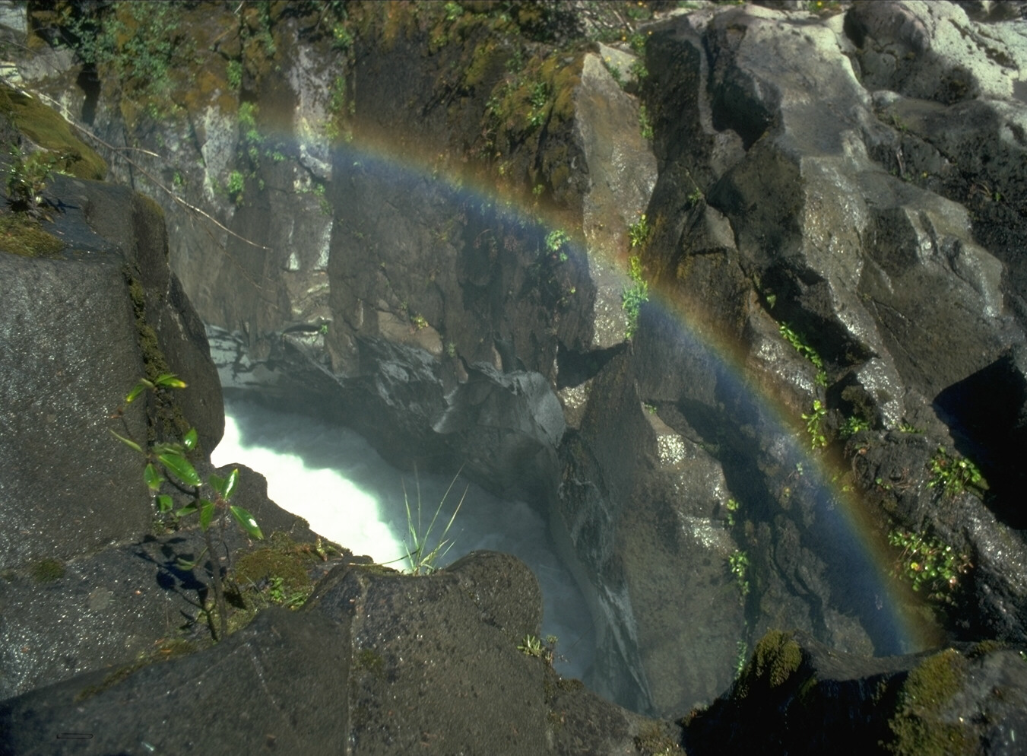
Jesus, God's Righteousness 3/4
Jesus, the expression of God's love,
The grace of God,
the Word of God,
revealed to us;
Jesus, God's holy sacrifice,
Now glorified, now justified,
His kingdom comes.

Slide 37
Jesus, God's Righteousness 4/4
And this kingdom will know no end,
And its glory shall know no bounds,
For the majesty and power
Of this kingdom's King has come;
And this kingdom's reign,
And this kingdom's rule,
And this kingdom's power and authority,
Jesus, God's righteousness revealed.

Slide 38
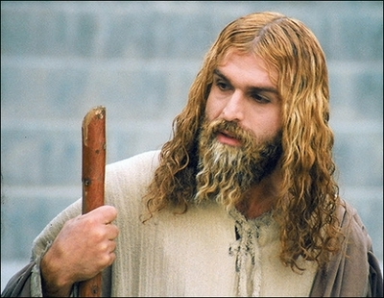
A Muslim actor as Jesus Christ in Iran (29 April 2008)
Who am I?
Notes:
http://latimesblogs.latimes.com/babylonbeyond/2008/04/iran-an-iranian.html
IRAN: A Muslim actor as Jesus Christ
Comments (19)
(13)
(0)
April 29, 2008 | 3:00 am
He is an Iranian Muslim who looks so much like a Hollywood or Renaissance image of Jesus Christ that the faithful sometimes make the sign of the cross when they see him.
Ahmad Soleimani-Nia has been playing Jesus for seven years, keeping his hair long and lightly dyed, his beard knotty and vibrant.
He is the star of "Jesus, the Spirit of God," a new film from Iran that depicts the man Christians believe to be the messiah and son of God as a tormented Judean prophet heralding the coming of Muhammad, the founder of the Muslim faith. Nia's Jesus is at once serene, devout, driven and passionate.
In real life, if there is a real life after a spiritual and artistic odyssey that is still not over, Nia lives in Tehran. He was once a soldier in the Iranian army and then a welder for — the irony is interesting in this Jesus story — his nation's Atomic Energy Agency, which the Bush administration accuses of pursuing nuclear weapons.
That may unsettle some American neo-cons, but perhaps not as much as the film itself, which suggests that Jesus wasn't crucified and never rose from the dead.
Check out the rest of the story in today's Los Angeles Times.
— Jeffrey Fleishman in Tehran
Photo: Ahmad Soleimani-Nia as Jesus. Credit: minbar.tatar.ru/rus/Messiah.htm

Slide 39
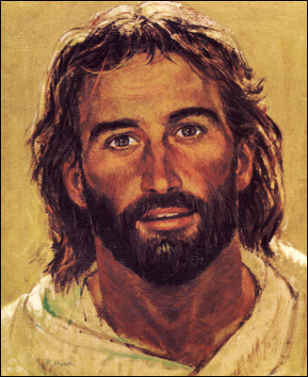
Jesus was relevant in the 1980s

Slide 40
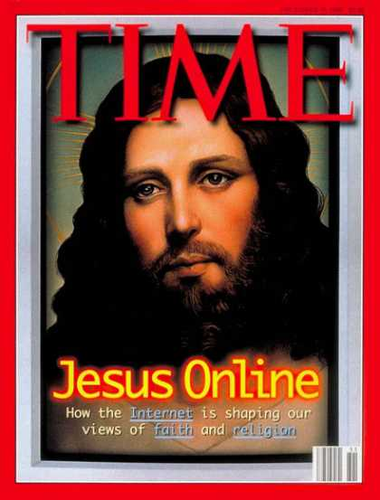
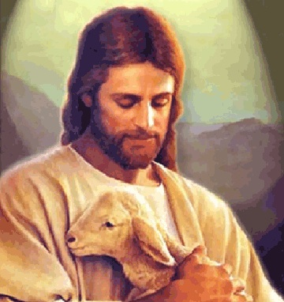
But Jesus became wimpy

Slide 41
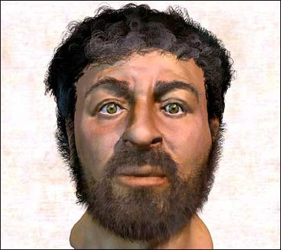
Here Jesus became a caveman
Notes:
This depiction of Christ was determined by collecting samples of first-century Jewish facial bone structures to provide a composite "average" man for that time.

Slide 42
Who is the Real King?
The Triumph of Christ
Notes:
My favourite instant coffee is the "American Flavour" Coffee King brand. Interestingly, each packet shows a king drinking coffee. Since America was established in rebellion to the King of England and the USA has never had a king, one wonders who this king is on the package! Nevertheless, it does raise the issue of who really rules the world. The book of Revelation is quite clear on this question as it removes all doubt in showing that Christ is the Ultimate Victor and Sovereign over all creation.

Slide 43
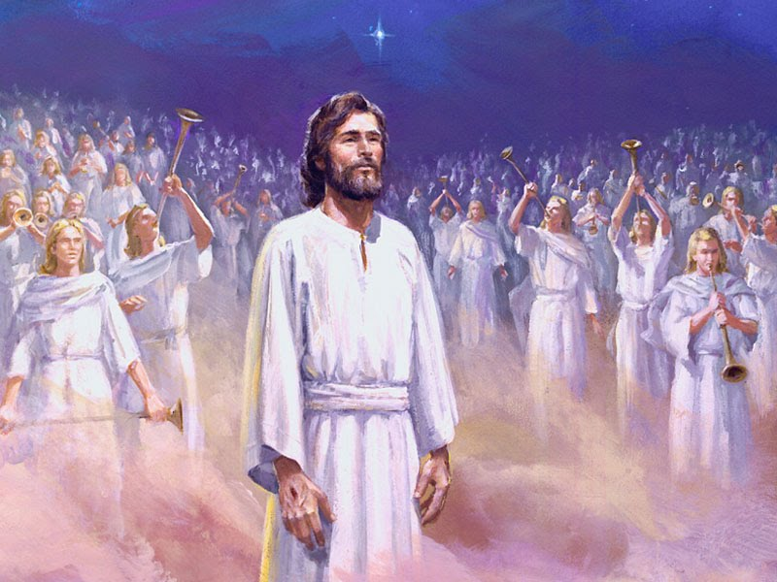
Jesus is the Real King!
318
The Triumph of Christ

Slide 44
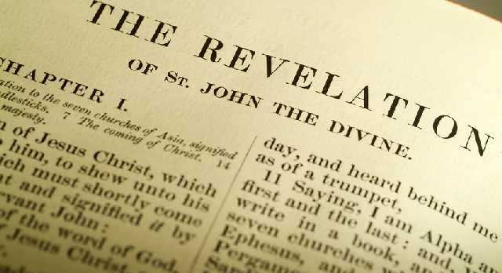
What's the Title?
319
The Book of Revelations?
The Book of Revelation

Slide 45
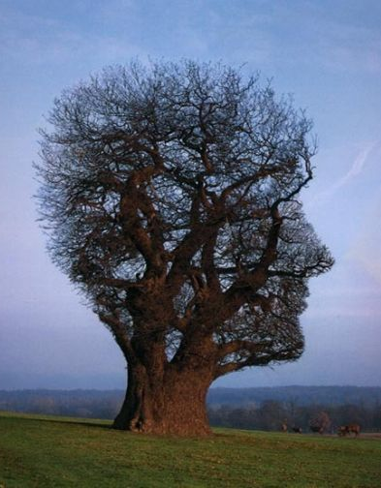
Who was this "John"?
319
John the Elder?
John the Prophet?
John the Baptist?
John the Apostle!
Author of:
Gospel of John
1 John
2 John
3 John

Slide 46
What books did John write?
509
Gospel of John | Epistles | Revelation
Believe 20:22 | Be Sure 1 John 5:13 | Be Ready 22:20
Life Received | Life Revealed | Life Rewarded
Salvation | Sanctification | Sovereignty
The Prophet | The Priest | The King
Warren Wiersbe, Bible Exposition Commentary

Slide 47
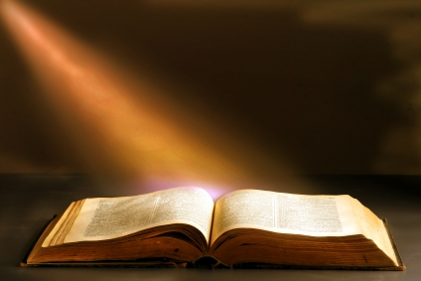
Evidence for John the Apostle as Author
320
"John, servant of Jesus Christ" (1:1, 4, 9; 22:8)
Characteristics:
Knows the history of churches in Asia Minor
Prophesies in own name
Stormy disposition as one of the "sons of thunder" (Mark 3:17) who calls Jews worshippers of Satan (2:9; 3:9)
Common ideas (e.g., use of contrast), theology, and terminology (e.g., logos in John 1:1; Rev. 19:13) between the Gospel of John and Revelation

Slide 48
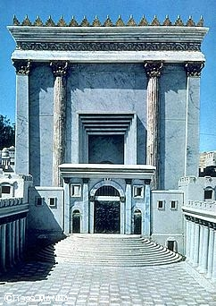
When Did John Write Revelation?
39-41, 320
Who was the Roman Emperor then?
Christ Crucified AD 33
Jerusalem Destroyed AD 70
Revelation Written AD 95
Tiberius 14-37
Caligula 37-41
Claudius 41-54
Nero 54-68
Vespasian 69-79
Titus 79-81
Domitian 81-96
Most preterists place the book here
Supported by: Irenaeus Victorinus of Pettau Clement of Alexandria Eusebius
Notes:
Emperors in black persecuted Christians
This course teaches that Revelation was written during the reign of Domitian at the end of the first century.

Slide 49
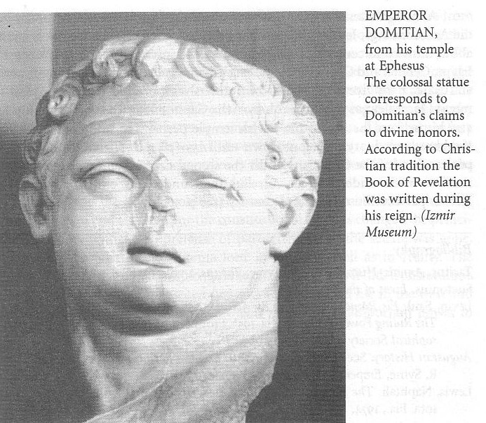
Domitian (AD 81-96)
This bust of Domitian was found in his huge temple at Ephesus—consistent with his claim to divine honors
Book of Revelation (AD 95)

Slide 50
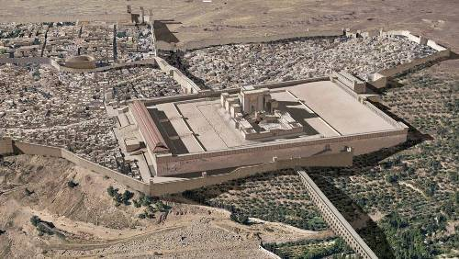
Was Jerusalem destroyed by this time?
320
Does 11:1-2 mean the temple still stood?
Bấy giờ có người ban cho tôi một cây lau giống như cây gậy, và biểu tôi rằng: Hãy đứng dậy đo đền thờ Đức Chúa Trời, bàn thờ, và những kẻ thờ lạy tại đó.
Còn sân ngoài đền thờ thì hãy để nó ra ngoài, đừng đo làm chi; vì chỗ đó đã phó cho dân ngoại, họ sẽ giày đạp thành thánh đủ bốn mươi hai tháng.
No, this text refers to a literal future temple during the Tribulation.
This is a vision.
Also, the 7th bowl (16:17–21) does not picture "the great city" as entirely destroyed until after John's time, so it looked to a future destruction.

Slide 51
Tổng Quan Tân Ước
38 124 39-41
“Cho đến tận cùng trái đất” (Công vụ 1:8)
CV 9 13 14 15 16 18 21 27 28
Tư 48- Chín 49
1 Galati
Tư 50- Chín 52
2 Êgiê
Xuân 53- Năm 57
3 Asi
Hai 60- Ba 62
1 Rôma
Xuân 62- Thu 67
4 T.B.Nha
Tám 67- Xuân 68
2 Rôma
Hè 35- 37
Damách Antiốt
Năm 57- Tám 59
Ra Tòa
Thu 49
Hội đồng
Xuân 68
Hội Thánh phát triển
35 48 49 50 52 53 57 60 62 67 68 95
Mat
Luca
Công vụ
Mác
Giăng
Gal
1 Tê
1 Cô
Eph
1 Ti
2 Ti
Giuđe
Giacơ
2 Tê
2 Cô
Col
Tít
Hê
1 Gi
Rôma
Phlm
1 Phi
2 Gi
Phúc Âm & Công vụ
Phil
2 Phi
3 Gi
Thư tín Phao-lô
1234
Hành trình
Rev
Thư tín Tổng quát
Rôma
Bị tù
No Animations

Slide 52
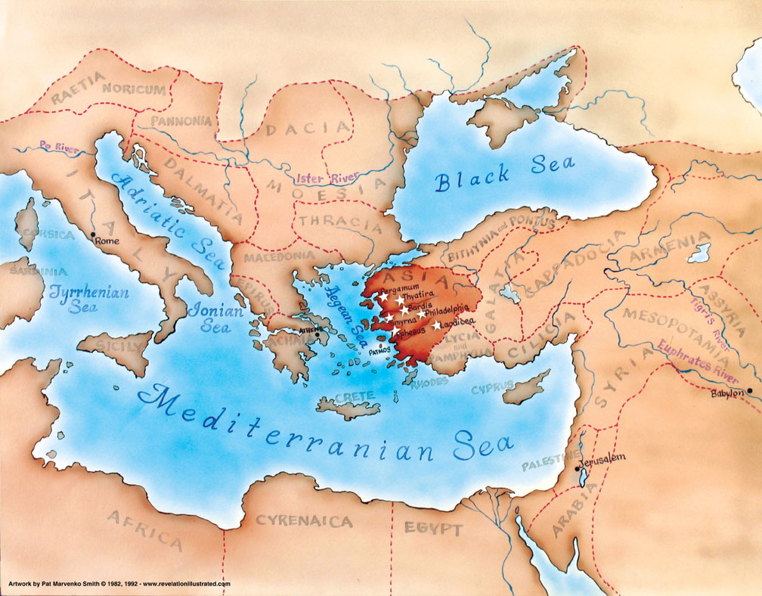
Asia in the Roman Empire
321

Slide 53
What did John see around him?
Title Page 321
Asian Churches
Rome
2. External Persecution from Rome (1:9; 2:9-10; 3:10)
1. Internal Struggles inside churches (2:4, 14-15, 21-24; 3:1, 15-17)

Slide 54
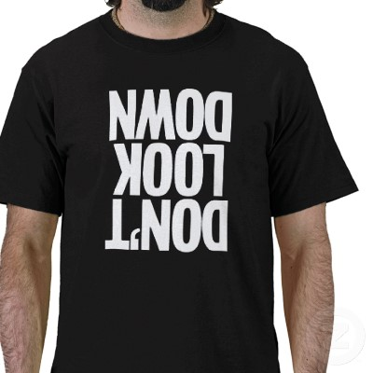
Don't Look Down
DON'T LOOK DOWN
Notes:
We are tempted to look down when things don't go our way

Slide 55
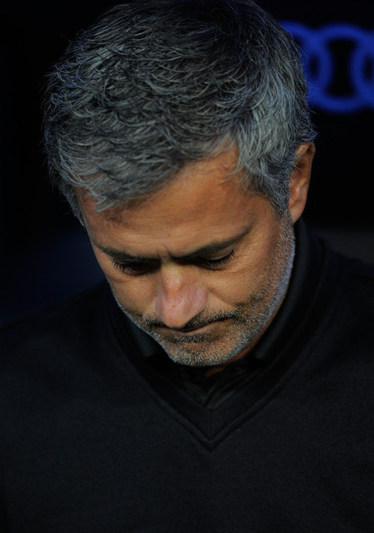
What causes you
Transition?
Finances?
Physical?
Relational?
… to look down?

Slide 56
How can you look up to the LORD during your struggle?

Slide 57
Revelation tells us to look up to…

Slide 58
The Sovereignty of Jesus Christ

Slide 59
Một Cảnh báo Stern(22:18-19)
p. 322 Point A
Tôi ngỏ cho kẻ nào nghe lời tiên tri trong sách nầy
nếu ai thêm vào sách tiên tri nầy điều gì, thì Đức Chúa Trời sẽ thêm cho người ấy tai nạn đã ghi chép trong sách nầy.
Và kẻ nào bớt điều gì trong những lời ở sách tiên tri nầy, thì Đức Chúa Trời sẽ cất lấy phần họ về cây sự sống và thành thánh, mà đã chép ra trong sách nầy.

Slide 60
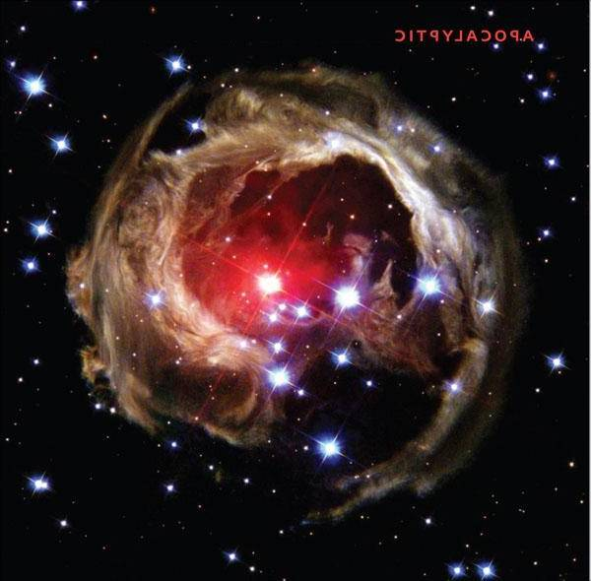
Revelation is the only NT book that deals primarily with the future
p. 322 Point B

Slide 61
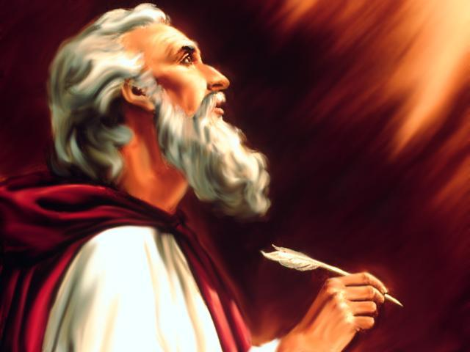
" Bấy giờ tôi xây lại đặng xem (1:12)
1:12
1:17
4:1
5:1
5:2
5:6
5:11
6:1
6:2
6:5
6:8
6:9
6:12
7:1
7:2
7:9
8:2
8:13
9:1
9:17
10:1
10:5
13:1
13:2
13:11
14:1
14:6
14:14
15:1
15:2
15:5
16:13
17:3
17:6
18:1
19:11
19:17
19:19
20:1
20:4
20:11
20:12
21:1
21:2
21:22
p. 322 Point B
This exact verb form is used 45 times in Revelation!
ei=don

Slide 62
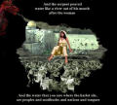
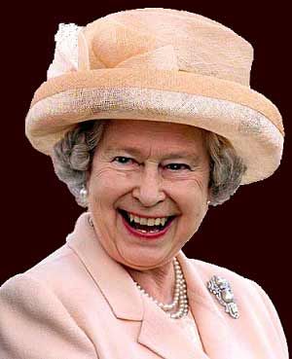
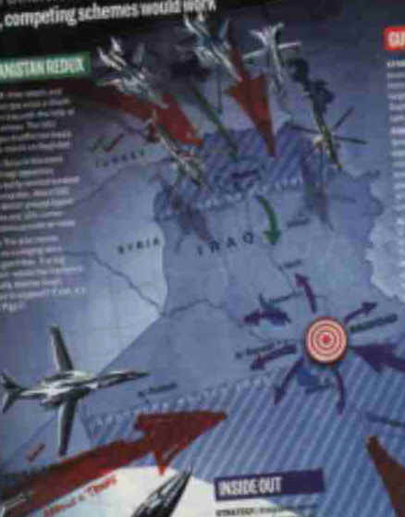
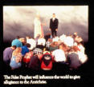
So Many Symbols, Lah
p. 322 Point C
So Many Interpretations!

Slide 63
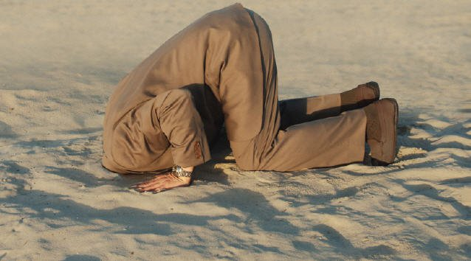
The Way Most People Interpret Revelation
322 C

Slide 64
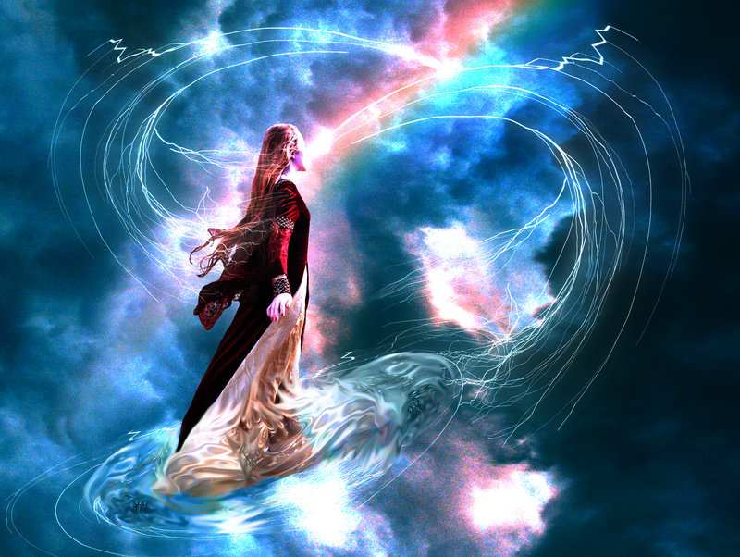
Why the Symbols?
322 C
Symbols have three advantages:
Symbols are a "spiritual code" to hide the truth from the unbelieving (cf. parables)
Symbolism is not weakened by time
Symbols not only convey information, but also impart values and arouse emotions
Warren Wiersbe, Bible Exposition Commentary

Slide 65
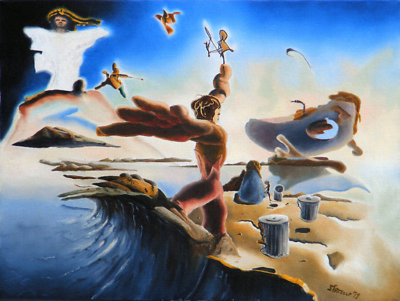
Revelation is the only apocalyptic NT writing
End times
p. 322 Point D
Warnings (not repentance)
Pessimism
Triumph of God
Secrecy
Determinism

Slide 66
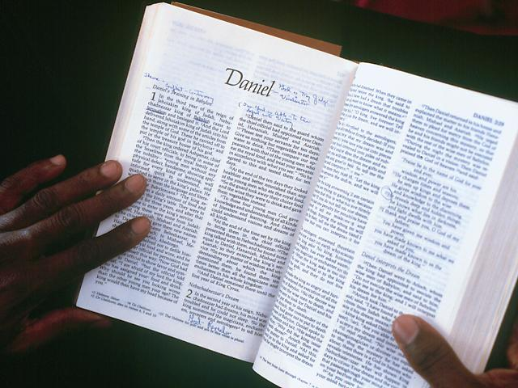
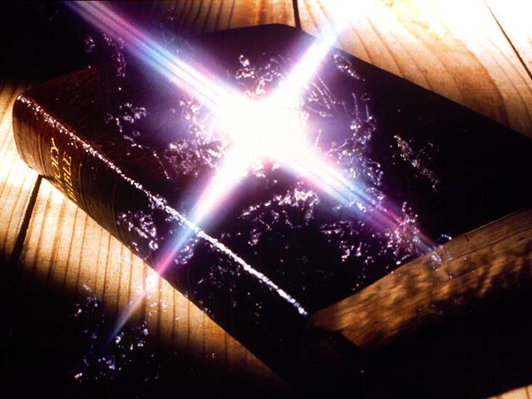
Characteristics
322
E. This book contains more allusions to the OT (250-550 allusions) than any NT writing. Ironically, Revelation also has very few quotes (1:7 quotes Zech. 12:10; 2:27 quotes Ps. 2:9).

Slide 67
Revelation Summarizes Scripture
322 E
The BOOK OF THE REVELATION
Σumming Up
of Scripture
The Rest of the Story

Slide 68
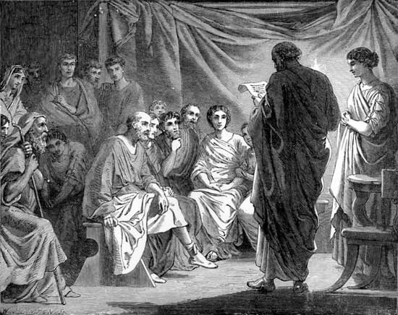
Characteristics
322
F. Chapters 2–3 record the only letters written by Christ that have been saved for us. This book also is the only NT writing with separate letters for various churches.

Slide 69
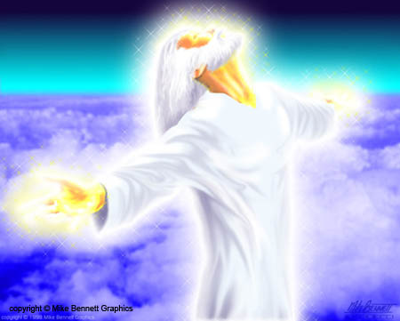
Characteristics
322
G. This prophecy completes our scriptural understanding about Jesus Christ with more about His glory than even the Gospels!

Slide 70
Focus: The Return of Christ
419 322 G
Terry Hall, Bible Panorama, 140
HE IS COMING !
HE IS COMING AGAIN !
OLD TESTAMENT
NEW TESTAMENT

Slide 71
Keys to Unlock the Revelation
322
Points H & I
God
Sự mặc thị của Đức Chúa Jêsus Christ mà Đức Chúa Trời đã ban cho Ngài đặng đem tỏ ra cùng tôi tớ Ngài những điều kíp phải xảy đến, thì Ngài đã sai thiên sứ đến tỏ những điều đó cho Giăng, tôi tớ Ngài,
là kẻ đã rao truyền lời Đức Chúa Trời và chứng cớ của Đức Chúa Jêsus Christ, về mọi điều mình đã thấy.
Jesus
Angel
Key Word: Triumph
Key Verse: "Write, therefore, what you have seen, what is now, and what will take place later" (1:19)
John
Readers (servants)
Notes:
"How did the Lord convey the contents of this book to His servant? According to Revelation 1:1–2, the Father gave the revelation to the Son, and the Son shared it with the apostle, using "His angel" as intermediary. Sometimes Christ Himself conveyed information to John (Rev. 1:10ff); sometimes it was an elder (Rev. 7:13); and often it was an angel (Rev. 17:1; 19:9–10). Sometimes a "voice from heaven" told John what to say and do (Rev. 10:4). The book came from God to John, no matter what the various means of communication were; and it was all inspired by the Spirit" (Wiersbe, Be Ready, Bible Exposition Commentary).

Slide 72
Characteristics
322
J. Revelation has more songs in its pages than any NT book. Angels break into worship 14 times making the book a model for worship. It especially parallels Ezekiel in its worship.

Slide 73
Characteristics
322
K. This is the only book in the Bible that promises a special blessing for reading it (1:3).

Slide 74
Characteristics
322
L. This is the only book written by John that bears his name in the text itself (1:1, 4, 9). Titles to NT books were added later.

Slide 75
Revelation
Sovereignty of Christ in Future Victory
Sovereignty in His Person |  |  | Sovereignty over Churches | Sovereignty in End-Time Events
Chapter 1 |  |  | Chapters 2–3 | Chapters 4–22
"What you have seen" (1:19a) |  |  | "What is now" (1:19b) | "What will take place later" (1:19c)
Past |  |  | Present | Future
Christ Unveiled |  |  | Churches Unveiled | Consummation Unveiled
God on Earth |  |  | God's Ambassadors on Earth | Hell on Earth to Heaven on Earth
The Judge |  |  | The Assignments | The Judgments & Rewards
Subject 1:1-3 | Worship of Trinity 1:4-8 | Glorified Christ 1:9-20 | Seven Churches of Asia: Ephesus Smyrna Pergamum Thyatira Sardis Philadelphia Laodicea | Tribulation 4:1–19:10 | Second Coming 19:11-21 | Millennium 20 | Eternal State 21:1–22:5 | Closing: Imminency 22:6-21
AD 95
318, 324 M

Slide 76
Paradise of Eden
325 N
Paradise of God

Slide 77
Four Views on Revelation 6–18
325 N, 326
Revelation 6–18 depicts which era?
Book Written AD 95
Book Read Today
Historicist
Futurist
Preterist
Idealist

Slide 78
Four Views on Revelation 6–18
2-3
Revelation 6–18 depicts which era?
Book Written AD 95
Book Read Today
Historicist
1999
1992 & 1995
Futurist
Preterist
1245 pages!
1256 pages!
Idealist

Slide 79
Do Interpretations Really Matter?
326
Notes:
Three blind men were asked to describe an elephant. Without the ability to see the whole animal, one who held the trunk said, "An elephant is like a tree branch." A second touched the large side of the animal and exclaimed, "No, an elephant is like a wall." The third blind man held onto the tail and concluded, "No, an elephant is like a rope!" Each man was sincere—but sincerely wrong!
Sometimes when approaching the book of Revelation people exclaim, "It means such and such" without seeing the whole picture. Another comes along and says that his opinion is better, and the same with a third. Each is seeing only a part of the truth.
Interpretations DO matter! The important thing is not what YOU think, or what I think. The key is to understand the book in its original context with the understanding that John recorded what Jesus intended, and Christ did not have just any ole thing in mind. Let's seek HIS understanding as we study.

Slide 80
Interpretive Views on Revelation
326
View & Advocates | Millennial View | Rev. 1–3 | Rev. 4–19 | Rev. 20–22
Idealist Beale Hendriksen Hughes | Postmillennial (or Amillennial) | Historic Churches | Symbolic of the non-historical conflict between good & evil | Victory of good over evil (Church over the world)
Preterist Sweete Ellicott DeMar | Apocalyptic | Historic Churches | Symbolic of Events in First Century (Nero, Mt. Vesuvius eruption) | Symbolic of heaven and victory
Historicist Luther Newton Elliott | Amillennial (or Postmillennial) | Historic Churches | Symbolic of events in the Church Age (fall of Rome, rise of Islam & Catholics, Reformation, etc.) | Present age (amil) or future millennium (postmil), general judgment, heaven
Futurist Thomas Walvoord Ryrie Ladd | Premillennial | Historic Churches &/or seven stages of church history | Future Tribulation judgments on apostate church and Antichrist, return of Christ | Future millennium, judgment, heaven

Slide 81
Premillennialism
433
Second Coming
Second
=
Advent
Tribulation
Millennium
Church Age
Eternal Kingdom
7 years
1000 years
Judgment
Judgment

Slide 82
Amillennialism
433
Second Coming
Millennium = Spiritual reign of Christ
Tribulations
Church Age
Eternal Kingdom
Judgment

Slide 83
Postmillennialism
433
Second Coming
Golden Age of the Gospel
Tribulations
Church Age
Eternal Kingdom
Judgment

Slide 84
Is there a future for ethnic believing Israel?
431
Dispensational
Premillennialism
Amillennialism &
Postmillennialism
Church & Israel distinct
Israel has a future
Church is new Israel
Israel has no future
Covenant
Premillennialism

Slide 85
Pretribulational Premillennialism
437
Rapture
2nd Advent
Great
White
Throne
Church Age
Tribulation
Millennium
Battle of
Armageddon
Battle of
Gog and Magog

Slide 86
4 Interpretive Principles
327
Principle #1:
Follow the normal sense unless it's nonsense
144,000 witnesses of Israel (7:4)
1000 years of saints' reign (20:4)
1260 days of prophesying (11:3)
3½ days of death (11:9)
Euphrates dries up (16:12)

Slide 87
What happens when the normal use of language is not followed?
327, 393
Revelation 16:12
Vị thiên sứ thứ sáu trút bát mình xuống sông cái O-phơ-rát; sông liền cạn khô, đặng sửa soạn cho các vua từ Đông phương đến có lối đi được.
100 commentaries
57 interpretations!
Notes:
87

Slide 88
200 million soldiers!
Revelation 9:13-16
Vị thiên sứ thứ sáu thổi loa, thì tôi nghe có tiếng ra từ bốn góc bàn thờ bằng vàng đặt trước mặt Đức Chúa Trời. Tiếng ấy nói cùng vị thiên sứ thứ sáu đương cầm loa rằng: Hãy cổi cho bốn vị thiên sứ bị trói trên bờ sông Ơ-phơ-rát. Bốn vị thiên sứ bèn được cổi trói, đã chực sẵn đến giờ, ngày, tháng, và năm ấy, hầu cho tiêu diệt một phần ba loài người. Số binh kỵ mã của đạo quân là hai trăm triệu; số đó tôi đã nghe.
339
Notes:
88

Slide 89
4 Interpretive Principles
327
Principle #1:
Follow the normal sense unless it's nonsense
144,000 witnesses of Israel (7:4)
1000 years of saints' reign (20:4)
1260 days of prophesying (11:3)
3½ days of death (11:9)
Euphrates dries up (16:12)
Weights (Rev. 16:21)

Slide 90
75-Pound Hailstones
Revelation 16:21 (Bowl #7)
Những cục mưa đá lớn, nặng bằng một ta-lâng, ở trên trời rớt xuống trên loài người; loài người bèn nói phạm đến Đức Chúa Trời bởi cớ tai nạn mưa đá ấy, vì là một tai nạn gớm ghê.
The largest single hailstone ever recorded in the United States was 7" in diameter, 18.75" around, and weighed in at just under 1 pound. Imagine a large cantaloupe falling from the sky at nearly 100 miles per hour! That hailstone fell during a storm in Aurora, Nebraska. The heaviest hailstone in the U.S. was 1.67 pounds and fell in Coffeyville, Kansas in 1970.
Notes:
http://myweathercontent.myweather.net/webhd/pkg/v2/template3.html?host=whio&section=4&page=42&story=350

Slide 91
4 Interpretive Principles
327
Principle #1:
Follow the normal sense unless it's nonsense
144,000 witnesses of Israel (7:4)
1000 years of saints' reign (20:4)
1260 days of prophesying (11:3)
3½ days of death (11:9)
Euphrates dries up (16:12)
Weights (16:21) and lengths (21:16)
The Number 7 (1:4, 12, 16, etc.)

Slide 92
The Number of
327
Completion
Creation Gen. 2:2
Rain Gen. 7:4
Sabbath Ex. 20:10
Jericho Josh. 6:4
Sons Job 1:2; Ruth 4:15
Prophecy Dan. 9:24
Forgive Matt. 18:21

Slide 93
Revelation Completion
328
Churches 1:4a
Spirits 1:4b
Lampstands 1:12
Stars 1:16
Seals 5:1
Eyes 5:6
Angels 8:2
Notes:
The word "seven" (hepta) appears 55 times in the book of Revelation.

Slide 94
Revelation Completion
328
Trumpets 8:2
Peals 10:3
7000 killed 11:13
Heads 12:3a
Diadems 12:3b
Plagues 15:1
Bowls 15:7
Notes:
The word "seven" (hepta) appears 55 times in the book of Revelation.

Slide 95
Revelation Completion
328
Mountains 17:9
Kings 17:10
Beatitudes 1:3; 14:13; 16:15; 19:9; 20:6; 22:7, 14
Notes:
"It is worth noting that there are seven "beatitudes" in Revelation: 1:3; 14:13; 16:15; 19:9; 20:6; 22:7, 14" (Wiersbe)

Slide 96
"But you can't take numbers literally in Revelation. It's prophetic literature!"
Really? Which text does not make sense if you understand the numbers in their normal sense?

Slide 97
The Four Most Common Approaches
326
PRETERIST - about 1st cent. AD history
FUTURIST - about history of the end of time
Dr. Henry Baldwin's - Combo #1, #2 & #4
HISTORICIST - about Church history to the present
IDEALIST - about good over evil in all times

Slide 98
Revelation 11
329
Revelation 11
A Test Case in Hermeneutics
Bấy giờ có người ban cho tôi một cây lau giống như cây gậy, và biểu tôi rằng: Hãy đứng dậy đo đền thờ Đức Chúa Trời, bàn thờ, và những kẻ thờ lạy tại đó. Còn sân ngoài đền thờ thì hãy để nó ra ngoài, đừng đo làm chi; vì chỗ đó đã phó cho dân ngoại, họ sẽ giày đạp thành thánh đủ bốn mươi hai tháng.
Ta sẽ cho hai người làm chứng ta mặc áo bao gai đi nói tiên tri trong một ngàn hai trăm sáu mươi ngày.

Slide 99
11:1 Measure
329
Revelation 11
Term or Expression | Beale Symbolic | Osborne Symbolic-Literal | Thomas Literal
1 "measure" (11:1) | "the infallible promise of God's future presence"; "the protec-tion of God's eschatologi-cal community"; "until the parousia" | "preservation of the saints spiritually in the coming great persecution"; "a prophetic anticipation of the final victory of the church" | "a mark of God's favor"

Slide 100
A Measuring Rod for Jerusalem (Zech. 2:1-4 NLT)
Ta lại ngước mắt lên và nhìn xem; kìa, một người cầm dây đo trong tay.
Zec người rằng: Ông đi đâu? Người đáp rằng: Taa đi đo Giê-ru-sa-lem, để xem bề rộng và bề dài nó là bao nhiêu.

Slide 101
11:1 Temple
329
Revelation 11
Term or Expression | Beale Symbolic | Osborne Symbolic-Literal | Thomas Literal
2 "the temple (naon)" (11:1) | "the temple of the church"; "Christians"; "the whole covenant community"; "…believers undergoing persecution yet protected by God" | heavenly temple depicting "the church, primarily the saints of this final period but secondarily the church of all ages" | "a future temple in Jerusalem during the period just before Christ returns"

Slide 102
11:1 Altar
329
Revelation 11
Term or Expression |  | Beale Symbolic | Osborne Symbolic-Literal | Thomas Literal
3 "the altar" (11:1) | "the suffering covenant community" |  | the [heavenly] altar of incense" | "the brazen altar of sacrifice in the court outside the sanctuary"

Slide 103
The Tabernacle

Slide 104
Solomon's Temple
Lavers
Court of Priests
Ark of the Covenant
Altar
Cherubim
Candlesticks
Boaz
Holy of Holies
Table of Showbread
Holy Place
Porch
Incense Altar
Jachin
Storerooms
Cubits
Bronze Sea
Court of Israelites

Slide 105
Solomon's Temple
Store Rooms
20 cu.
(30 ft.)
Most Holy Place
Holy Place
Altar
Sea
About 90 cubits (135 ft.)
10 cu.(15 ft.)

Slide 106
11:2 Gentiles
329
Revelation 11
Term or Expression | Beale Symbolic | Osborne Symbolic-Literal | Thomas Literal
8 "the Gentiles" (11:2) | "the Gentiles and Jews" | "the church handed over to the Gentiles/ nations for a time" | "a group [of non-Jews] in rebellion against God who will oppress the Jewish remnant"

Slide 107
11:2 Holy City
329
Revelation 11
Term or Expression | Beale Symbolic | Osborne Symbolic-Literal | Thomas Literal
10 "the holy city" (11:2) | "the initial form of the heavenly city, part of which is identified with believers living on earth" | "the people of God" | "the literal city of Jerusalem on earth"

Slide 108
11:2 Forty-Two Months
330
Revelation 11
Term or Expression | Beale Symbolic | Osborne Symbolic-Literal | Thomas Literal
11 "forty-two months" (11:2) | "figurative for the eschatological period of tribulation"; "attack on the community of faith throughout the church age" | "the great tribulation at the end of history" | "the last half of Daniel's seventieth week"

Slide 109
The Two Olive Trees (11:4)
330

Slide 110
11:3 Two Witnesses
330
Revelation 11
Term or Expression | Beale Symbolic | Osborne Symbolic-Literal | Thomas Literal
12 "the two witnesses" (11:3) | the church; "the whole community of faith" | "two major eschatological figures… as a symbol for the witnessing church" | two future prophets, probably Moses and Elijah

Slide 111
11:8 Great City
330
Revelation 11
Term or Expression | Beale Symbolic | Osborne Symbolic-Literal | Thomas Literal
13 "the great city" (11:8) | "Babylon" = "Rome" = "the ungodly world" | Jerusalem and Rome; secondarily, all cities that oppose God | Jerusalem

Slide 112
11:11-12 Resurrect Two Witnesses
330
Revelation 11
Term or Expression | Beale Symbolic | Osborne Symbolic-Literal | Thomas Literal
14 the resurrec-tion and ascension of the two witnesses (11:11-12) | "divine legitimiza-tion of a prophetic call" | "A proleptic anticipation of the 'rapture' of the church" | the resurrection of the two witnesses

Slide 113
Let's now put each view into paragraph form like the passage
330

Slide 114
Symbolic Summary (Beale)
Revelation 11 - Beale (Symbolic)
330
¹I was given a reed symbolizing the infallible promise of God's future presence and was told, "Go and protect God's escha-tological community (which is the temple of the church) until the parousia and protect the suffering covenant community and count the believers worshiping together in the temple community. ²But exclude God's true people, including Gentiles; do not protect this suffering covenant community of Gentiles and Jews because they are not protected from various forms of earthly harm (physical, economic, social, etc.). They will attack and persecute the whole community of faith throughout the church age which is the initial form of the heavenly city, part of which is identified with believers living on earth for the eschatological period of tribulation. ³And I will give power to the church, and this whole community of faith will prophesy for the eschatological period of tribulation… [but after being killed] ⁸their bodies will lie in the street of Babylon or Rome which means the ungodly world [then they will receive] ¹¹⁻¹²divine legitimization of a prophetic call.

Slide 115
Symbolic-Literal Summary (Osborne)
Revelation 11 - Osborne (Symbolic-Literal)
330
¹I was given a reed like a measuring rod and was told, "Go and preserve the saints spiritually in the coming great persecution (but secondarily the church of all ages) in anticipation of their final victory and measure (preserve?) the [heavenly] altar of incense, and count the individual believers in the church or at the altar. ²But exclude the saints who are persecuted… because they have not been protected from Gentiles/nations as God delivers his followers into the hands of sinners for a time. The saints will suffer incredibly in a physical sense in the people of God for the 'great tribulation' at the end of history. ³And I will give power to my witnessing church, and they will prophesy for 1,260 days, clothed in sackcloth… [but after being killed] ⁸their bodies will lie in the street of Jerusalem and Rome which secondarily refer to all cities that oppose God [then they will receive] ¹¹⁻¹²a proleptic anticipation of the 'rapture' of the church.

Slide 116
Literal Summary (Thomas)
330
Revelation 11 - Thomas (Literal)
¹I was given a reed like a measuring rod and was told, "Go and measure as a mark of God's favor the future temple in Jerusalem during the period just before Christ returns and the brazen altar of sacrifice in the court outside the sanctuary, and count the future godly remnant in Israel in the rebuilt temple. ²But do not measure as a mark of God's favor the wicked without God… because they have been excluded from God's favor [and are] a group [of non-Jews] in rebellion against God who will oppress the Jewish remnant. They will trample on Jerusalem for the last half of Daniel's seventieth week. ³And I will give power to my two future prophets (probably Moses and Elijah), and they will prophesy for 1,260 days, clothed in sackcloth… [but after being killed] ⁸their bodies will lie in the street of Jerusalem [then three and a half days later will] ¹¹⁻¹²be resurrected.

Slide 117
Principle #2:
331
4 Interpretative Principles
Be consistent with Daniel's parallel prophecy

Slide 118
Daniel
331
Ten-horned Beast
7-year covenant
1290/1260-day trial
Revelation

Slide 119
Outline of Daniel
331
UNIVERSAL SOVEREIGNTY IN TIMES OF THE GENTILES
Sovereignty over Daniel |  |  | Sovereignty over Gentiles |  |  |  |  |  | Sovereignty over Jews
Chapter 1 |  |  | Chapters 2–7 |  |  |  |  |  | Chapters 8–12
Narrative |  |  | Visions in Narrative |  |  |  |  |  | Vision
Hebrew |  |  | Aramaic |  |  |  |  |  | Hebrew
Gentile Names for God |  |  | Gentile Names for God |  |  |  |  |  | Jewish Names for God
Third person ("Daniel") |  |  | Third person ("Daniel") |  |  |  |  |  | First person ("I")
Daniel's Example |  |  | Daniel Interprets King's Dreams |  |  |  |  |  | Angel Interprets Daniel's Dreams
The Man Daniel |  |  | Images |  | Kings |  |  |  | Israel's Future
Exile 1:1-7 | Food 1:8-16 | Exalted 1:17-21 | Varied 2 Promoted | Gold 3 Furnace | Neb. 4 Exile | Bel. 5 Party | Dar. 6 Lions | All 7 Beasts | Medo- Persia To Greece 8 | Return to Seventy "7s" 9 | Intertest-ament Period to Tribulation 10-12
Babylon
605-536 BC

Slide 120
Nations in Daniel 7
331
Babylon
Greece
Rome
Medo-Persia

Slide 121
Beast 1: Winged Lion (Babylon)
331

Slide 122
Beast 2: Bear (Medo-Persia)
331

Slide 123
Beast 3: Leopard (Greece)
331

Slide 124
Beast 4: Terrifying (Rome)
331
Daniel 7:7

Slide 125
Little Horn on Beast 4 (Antichrist)
331
Daniel 7:8

Slide 126
Daniel's 70 Weeks (Dan. 9:24-27)
332
69 Weeks
444 BC
AD 33

Slide 127
Dating Daniel's Seventy Weeks
332

Slide 128
Chronology of the 70th "Week"
333
336
Adapted from J. Dwight Pentecost, Dallas Theological Seminary, 1988
Middle of the Week
Sign of Son of Man Matt. 24:30
Christ's Return Complete
3½ YEARS
1290 DAYS
Dan. 12:11
30 DAYS
30 DAYS
1260 DAYS
45 DAYS
Rev. 11:3; 12:6
Dan. 12:12
3½ YEARS
3½ YEARS
Election of Beast Rev. 17:13
Covenant Made Dan. 9:27a
Covenant Broken Dan. 9:27b
2nd ADVENT
The Great Tribulation
The Tribulation

Slide 129
Principle #3:
334
4 Interpretative Principles
Assume a chronological order
Vừa thấy người, tôi ngã xuống chơn người như chết; nhưng người đặt tay hữu lên trên tôi, mà rằng: Đừng sợ chi, ta là Đấng trước hết và là Đấng sau cùng,
là Đấng Sống, ta đã chết, kìa nay ta sống đời đời, cầm chìa khóa của sự chết và âm phủ.
Vậy hãy chép lấy những sự ngươi đã thấy, những việc nay hiện có và những việc sau sẽ đến,
have seen
are
will take place

Slide 130
The Recapitulation Approach
335
Christ in the Midst of the Seven Lamp Stands (1–3)
Seven literal churches of Asia each depict conditions in congregations throughout the church age until Christ's return (1:7)
The Vision of Heaven and the Seven Seals (4–7)
Christ rules from heaven now (5:5-6) until the second coming (6:16-17) with the triumphant church (7:16-17)
The Seven Trumpets (8–11)
A series of church age judgments afflicts the wicked (8–9) but the Church is protected (10–11) until the final judgment (11:15, 18)
The Persecuting Dragon (12–14)
A woman (the Church) bears a child (Christ) but the dragon (Satan) persecutes her (believers) until the second coming (14:14, 16)
The Seven Bowls (15–16)
The disappearance of islands and mountains (16:20) is the final judgment along with "events that… take place in connection with it"
The Fall of Babylon (17–19)
Babylon (the world system of seduction) exists during the entire church age until its destruction at Christ's second coming (19:11-21)
The Great Consummation (20–22)
The present age (20:1-6) is not a literal 1000 years, comes before chapter 19, and is followed by a general judgment and eternity

Slide 131
Modified Recapitulation Approach
STRUCTURE OF THE REVELATION TO JOHN
VERIFICATION & BLESSINGS
EPISTOLARY GREETINGS
VISION OF CHRIST
LETTERS
VISION OF
#
TO THE
THE SIX SEALS
Interlude
7
CHURCHES
GOD
#1
#
The
Interlude
7
THE SIX TRUMPETS
#2
Explanation
THE SEVEN LAST BOWLS
The
š
Final
THE NEW
Events
JERUSALEM
N
š
View of Dr. Henry Baldwin, SBC
VISION OF CHRIST
VERIFICATION & CURSES
EPISTOLARY CLOSING

Slide 132
Problems with Recapitulation
335-337
1. See rebuttals to the right of the Recapitulation diagram.
2. Does Christ's return really appear repeatedly in the book?
"The strongest argument for the recapitulation view is the observation of repeated combined scenes of consummative judgment and salvation found in various sections throughout the book"
––G. K. Beale, The Book of Revelation, GIGTC (Grand Rapids: Eerdmans, 1999), 121
3. Judgments increasingly progress and intensify.
Bowls
Trumpets
Cycles:
Seals

Slide 133
Recapitulation Critiqued
336
But 16:18-20 earthquake is even worse
Tôi nhìn xem, khi Chiên Con mở ấn thứ sáu, thì có một cơn động đất lớn; mặt trời bèn trở nên tối tăm như túi lông đen, cả mặt trăng trở nên như huyết.
Rev 6:13 Các vì sao trên trời sa xuống đất, như những trái xanh của một cây vả bị cơn gió lớn lung lay rụng xuống.
Rev 6:14 Trời bị dời đi như quyển sách cuốn tròn, và hết thảy các núi các đảo bị quăng ra khỏi chỗ mình;
Actually a meteor shower as not all the stars fall
But sky not replaced until 21:1
But 6:16 still has some mountains (cf. 16:20 "every island & mountain fled")

Slide 134
Do chapters 4–22 refer to the present age?
339
When did 25% of the world die (6:8)?
When was there an army of 200 million (9:16; 16:12-14)?
When has man witnessed 75-pound hail (16:21)?

Slide 135
Content of the Judgments
337
 | SEALS | TRUMPETS | BOWLS
1 | White: conqueror | Hail & fire: 1/3 vegetation | Sores
2 | Red: war | Fire: 1/3 sea creatures | Sea to blood
3 | Black: famine | Star: 1/3 fresh water | Fresh water to blood
4 | Pale: death | Dark: 1/3 sun, moon, stars | Sun burns men
 |  | (Trumpets 5-7 are woes)
5 | Martyrs reassured | Woe #1: locusts | Beast's kingdom dark
6 | Wrath: earthquake, signs | Woe #2: Euphrates prep | Euphrates dries up
 | (144,000 sealed) | (Trump #7 = mystery)
7 | 1/2 hour silence | Woe #3: victory imminent | Earthquake & hail
H O R S E S
W O E S
Adapted from Robert Gromacki, NT Survey and H. Wayne House, Chronological & Background Charts of the NT, 19
Notes:
135

Slide 136
Problems with Recapitulation
338
"The strongest argument for the recapitulation view is the observation of repeated combined scenes of consummative judgment and salvation found in various sections throughout the book"
––G. K. Beale, The Book of Revelation, GIGTC (Grand Rapids: Eerdmans, 1999), 121
But...
3. Judgments increasingly progress and intensify.
Bowls
Trumpets
Cycles:
Seals
Satan:
Cast to earth (12:8-9)
Locked in Abyss (20:1)
Lake of Fire (20:10)

Slide 137
Principle #4:
338
4 Interpretative Principles
Use Revelation's inspired outline
chơn như đồng sáng đã luyện trong lò lửa, và tiếng như tiếng nước lớn. Tay hữu người cầm bảy ngôi sao; miệng thò ra thanh gươm nhọn hai lưỡi và mặt như mặt trời khi soi sáng hết sức. Vừa thấy người, tôi ngã xuống chơn người như chết; nhưng người đặt tay hữu lên trên tôi, mà rằng: Đừng sợ chi, ta là Đấng trước hết và là Đấng sau cùng, là Đấng Sống, ta đã chết, kìa nay ta sống đời đời, cầm chìa khóa của sự chết và âm phủ. Vậy hãy chép lấy những sự ngươi đã thấy, những việc nay hiện có và những việc sau sẽ đến,
have seen
are
will take place

Slide 138
Chronology of Revelation
340
"What you have seen"
(1:19a)
Rev. 1
"What is now"
(1:19b)
Rev. 2–3
"What will take place later"
(1:19c)
Rev. 4–22
Vision of Christ
Church Age
Rapture 3:10
Tribulation
4:1 – 19:10
Second Coming
Millennium
First Half
Second Half
Eternal State
Great White Throne Judgment
Copyright 1989 Rick Griffith
Adapted from a chart by J. D. Pentecost
Notes:
The 3 main divisions of Revelation are summarized in 1:19
The 3 main cycles of judgment are squared in blue
The 4 parenthetical sections appear in parentheses within the scrolls. They do not advance the chronology but add important information that is not associated with a particular judgment.

Slide 139
The Twofold Context of the Book
Internal Compromise
321
External Persecution
Patmos
Tôi là Giăng, là anh em và bạn của các anh em về hoạn nạn, về nước, về sự nhịn nhục trong Đức Chúa Jêsus, tôi đã ở trong đảo gọi là Bát-mô, vì cớ lời Đức Chúa Trời và chứng của Đức Chúa Jêsus. Rev 1:9 Viet
Notes:
Two factors will help us understand the historical situation in AD 95 with these churches scattered throughout the Empire:
External persecution against the churches is noted in 1:9 [click] that began in Rome and spread by imperial edict
Internal compromise within most churches is rebuked in chapters 2-3: division, false teaching, sinful living, self-centered luxurious lifestyles, etc.
What evidence of internal compromise and eternal persecution do you see in your own experience today? How can you relate?

Slide 140
Summing Up the Whole Book
343
God discloses through John the sovereignty of Jesus Christ in His ultimate future triumph to encourage believers to persevere despite internal compromise and external opposition

Slide 141
John at Patmos (1:9-10)
343
Notes:
"Tradition says that it was Domitian who sent John to the Isle of Patmos, a Roman penal colony off the coast of Asia Minor. This being the location of John's exile, perhaps it is not surprising that the word sea is found twenty-six times in his book" (Warren Wiersbe, Bible Exposition Commentary)

Slide 142
Why should we know that Jesus rules the world?
318
Why read Revelation?
Why worship Jesus?
Why see Jesus clearly?

Slide 143
I. Reading and obeying this Revelation of Christ's sovereignty brings blessing (1:1-3).
343

Slide 144
Christ's sovereignty over future events transmitted to John shows the prophecy as inspired (1:1-2)
322
Points H & I
God
Sự mặc thị của Đức Chúa Jêsus Christ mà Đức Chúa Trời đã ban cho Ngài đặng đem tỏ ra cùng tôi tớ Ngài những điều kíp phải xảy đến, thì Ngài đã sai thiên sứ đến tỏ những điều đó cho Giăng, tôi tớ Ngài,
là kẻ đã rao truyền lời Đức Chúa Trời và chứng cớ của Đức Chúa Jêsus Christ, về mọi điều mình đã thấy. Rev 1:1,2 Viet
Jesus
Angel
John
Readers (servants)
Notes:
"How did the Lord convey the contents of this book to His servant? According to Revelation 1:1–2, the Father gave the revelation to the Son, and the Son shared it with the apostle, using "His angel" as intermediary. Sometimes Christ Himself conveyed information to John (Rev. 1:10ff); sometimes it was an elder (Rev. 7:13); and often it was an angel (Rev. 17:1; 19:9–10). Sometimes a "voice from heaven" told John what to say and do (Rev. 10:4). The book came from God to John, no matter what the various means of communication were; and it was all inspired by the Spirit" (Wiersbe, Be Ready, Bible Exposition Commentary).

Slide 145
Characteristics
322
This is the only book in the Bible that promises a special blessing for reading it (1:3).
Phước cho kẻ đọc cùng những kẻ nghe lời tiên tri nầy, và giữ theo điều đã viết ra đây. Vì thì giờ đã gần rồi. Rev 1:3 Viet

Slide 146
We often look down…

Slide 147
…so why should you look up and why worship Jesus during your struggle?

Slide 148
II. We should worship the triune God because Christ will soon return (1:4-8).

Slide 149
"Grace and peace to you from the one who is, who always was, and who is still to come"
Father
Rev. 1:4-6
is
is not
is not
GOD
is
is
Son
Spirit
"and from Jesus Christ…"
"…from the sevenfold Spirit before his throne"
is not
H. Wayne House, Charts of Christian Theology and Doctrine, 45

Slide 150
Redemption in Christ (1:5b-6)
" Rev 1:5 lại từ nơi Đức Chúa Jêsus Christ là Đấng làm chứng thành tín, sanh đầu nhứt từ trong kẻ chết và làm Chúa của các vua trong thế gian!
Rev 1:6 Đấng yêu thương chúng ta, đã lấy huyết mình rửa sạch tội lỗi chúng tôi, và làm cho chúng ta nên nước Ngài, nên thầy tế lễ của Đức Chúa Trời và Cha Ngài, đáng được sự vinh hiển và quyền năng đời đời vô cùng! A-men.

Slide 151
Kìa, Ngài đến giữa những đám mây, mọi mắt sẽ trong thấy, cả đến những kẻ đã đâm Ngài cùng trông thấy; hết thảy các chi họ trong thế gian sẽ than khóc vì cớ Ngài. Quả thật vậy. A-men!
Rev. 1:7 VIET
cf. Zech. 12:10

Slide 152
The Repentance of Israel
" Ta sẽ đổ thần của ơn phước và của sự nài xin ra trên nhà Đa-vít, và trên dân cư Giê-ru-sa-lem; chúng nó sẽ nhìn xem ta là Đấng chúng nó đã đâm; và chúng nó sẽ thương khóc, như là thương khóc con trai một, sẽ ở trong sự cay đắng vì cớ con đầu lòng. “
(Zech. 12:10 Viet).

Slide 153
"Look! He comes with the clouds of heaven. And everyone will see him— even those who pierced him. And all the nations of the world will mourn for him. Yes! Amen!"
Rev. 1:7 NLT
cf. Zech. 12:10

Slide 154
Chúa là Đức Chúa Trời, Đấng Hiện Có, Đã Có, Và Còn Đến, là Đấng Toàn năng, phán rằng: Ta là An-pha và Ô-mê-ga. (1:8 Viet).
iii

Slide 155
Why see Jesus clearly?
343
Notes:
"Tradition says that it was Domitian who sent John to the Isle of Patmos, a Roman penal colony off the coast of Asia Minor. This being the location of John's exile, perhaps it is not surprising that the word sea is found twenty-six times in his book" (Warren Wiersbe, Bible Exposition Commentary)

Slide 156
III. Seeing Christ glorified shows He can solve your problems (1:9-20).
343

Slide 157
The Twofold Context of the Book
Internal Compromise
321
External Persecution
Patmos
"I, John, am your brother and your partner in suffering and in God's Kingdom and in the patient endurance to which Jesus calls us. I was exiled to the island of Patmos for preaching the word of God and for my testimony about Jesus" (Rev. 1:9 NLT)
Notes:
Two factors will help us understand the historical situation in AD 95 with these churches scattered throughout the Empire:
External persecution against the churches is noted in 1:9 [click] that began in Rome and spread by imperial edict
Internal compromise within most churches is rebuked in chapters 2-3: division, false teaching, sinful living, self-centered luxurious lifestyles, etc.
What evidence of internal compromise and eternal persecution do you see in your own experience today? How can you relate?

Slide 158
The Island of Patmos
Notes:
"The small island of Patmos is about 7.5 miles (12 km) long from north to south and at its widest is 6 miles (10 km) from east to west. It is the northernmost island of the Dodecanese. With an area of 13 square miles (35 sq. km) and a circumference of 25 miles (37 km), the volcanic island presents a largely rocky and treeless landscape" (http://www.bibleplaces.com/patmos.htm).

Slide 159
Satellite Comparison of Singapore with Patmos
Patmos

Slide 160
The Tourist Island of Patmos
Patmos Island

Slide 161
Luxury Hotels on Patmos

Slide 162
Monastery of St. John at Patmos
Notes:
"The most imposing building on the island is the Monastery of St. John the Theologian. Constructed by Christodoulos in 1088, the monastery is located in the town of Chora overlooking the harbor. With walls 50 feet (15 m) high, it was built like a fortress because of the threat from pirates. The monastery was built on top of the remains of a 4th century AD church and an earlier temple of Artemis. An inscription that mentions the temple of Artemis is displayed in the monastery's museum" (http://www.bibleplaces.com/patmos.htm).

Slide 163
John's View from the Top

Slide 164
John's View from the Top

Slide 165
"… Nhằm ngày của Chúa, …" (1:10)
319
Sunday?
The "Day of the LORD"?

Slide 166
The Day of the LORD
OT Survey 638-639
Judgment
+
Blessing
Tribulation
Millennium
Rev. 6–19
Rev. 20
7 years
1000 years

Slide 167
John's vision of the glorified Christ proves He can handle the Church's internal and external problems (1:12-16)
343
Notes:
"Christ's garments are those of a Judge-King, One with honor and authority. The white hair symbolizes His eternality, "the Ancient of Days" (Dan. 7:9, 13, 22). His eyes see all (Rev. 19:12; Heb. 4:12), enabling Him to judge righteously. His feet of burning brass also suggest judgment, since the brazen altar was the place where the fire consumed the sin offering. The Lord had come to judge the churches, and He would also judge the evil world system.
The "sound of many waters" (Rev. 1:15) makes me think of Niagara Falls! Perhaps two ideas are suggested here: (1) Christ gathers together all the "streams of revelation" and is the Father's "last Word" to man (Heb. 1:1–3); (2) He speaks with power and authority and must be heard. The sword from His mouth certainly represents the living Word of God (Heb. 4:12; Eph. 6:17). He fights His enemies by using His Word (Rev. 2:16; 19:19–21)" (Wiersbe).

Slide 168
" , Bấy giờ tôi xây lại đặng xem tiếng…“ (1:12)
1:12
1:17
4:1
5:1
5:2
5:6
5:11
6:1
6:2
6:5
6:8
6:9
6:12
7:1
7:2
7:9
8:2
8:13
9:1
9:17
10:1
10:5
13:1
13:2
13:11
14:1
14:6
14:14
15:1
15:2
15:5
16:13
17:3
17:6
18:1
19:11
19:17
19:19
20:1
20:4
20:11
20:12
21:1
21:2
21:22
p. 322 Point B
This exact verb form is used 45 times in Revelation!
ei=don

Slide 169
NOW…TO COMPLETE THE PORTRAIT…
343
Revelation 1:12-18 (NIV) ¹²I turned around to see the voice that was speaking to me. And when I turned I saw seven golden lamp stands,
THE REVELATION OF JESUS CHRIST TO JOHN THE APOSTLE
MATTHEW
MARK
¹³and among the lamp stands was someone "like a son of man," dressed in a robe reaching down to his feet and with a golden sash around his chest.
¹⁴His head and hair were white like wool, as white as snow, and his eyes were like blazing fire.
¹⁵His feet were like bronze glowing in a furnace, and his voice was like the sound of rushing waters.
¹ ¹⁶In his right hand he held seven stars, and out of his mouth came a sharp double-edged sword. His face was like the sun shining in all its brilliance.
LUKE
JOHN
¹⁷When I saw him, I fell at his feet as though dead. Then he placed his right hand on me and said: "Do not be afraid. I am the First and the Last.
¹⁸I am the Living One; I was dead, and behold I am alive for ever and ever! And I hold the keys of death and Hades."
28
9
Notes:
Now…to complete the portraits given to us by
MATTHEW…MARK…LUKE…and JOHN.
//// For this, we need to get out into space and look at this unfortunate planet. Man has made a mess of it, you will probably agree. This view of earth helps us more clearly understand the final view of Christ given to us in the New Testament.
//// Now travel to the last book of the New Testament…The Revelation of Jesus Christ to John the Apostle. There, we see Jesus Christ in His risen, ascended glory, as he will appear when He returns at the end of History to reclaim all that is His.
//// In his first chapter of The Revelation, John writes this:
I turned around to see the voice that was speaking to me. And when I turned I saw seven golden lamp stands…
//// and among the lamp stands was someone "like a son of man," dressed in a robe reaching down to his feet and with a golden sash around his chest.
//// His head and hair were white like wool, as white as snow, and his eyes were like blazing fire.
//// His feet were like bronze glowing in a furnace, and his voice was like the sound of rushing waters.
//// In his right hand he held seven starts, and out of his mouth came a sharp double-edged sword. His face was like the sun shining in all its brilliance.
//// When I saw him, I fell at his feet as though dead. Then he placed his right hand on me and said: "Do not be afraid. I am the First and the Last.
//// I am the Living one; I was dead, and behold I am alive forever and ever! And I hold the keys the death and Hades.

Slide 170
"… , và tiếng như tiếng nước lớn. " (1:15)
Notes:
"The "sound of many waters" (Rev. 1:15) makes me think of Niagara Falls! Perhaps two ideas are suggested here: (1) Christ gathers together all the "streams of revelation" and is the Father's "last Word" to man (Heb. 1:1–3); (2) He speaks with power and authority and must be heard." (Wiersbe).

Slide 171
Tay hữu người cầm bảy ngôi sao; miệng thò ra thanh gươm nhọn hai lưỡi và mặt như mặt trời khi soi sáng hết sức. (1:16)
Notes:
"The sword from His mouth certainly represents the living Word of God (Heb. 4:12; Eph. 6:17). He fights His enemies by using His Word (Rev. 2:16; 19:19–21)" (Wiersbe).

Slide 172
OT Parallels to Jesus in Rev. 1:12-16
343
Rev. 1:12-16 | Ezek. 1:24-28 | Dan. 10:5-6 | Dan. 7:9-10 | Dan. 7:13-14
son of man | like that of a man | a man |  | son of man
robe |  | linen robe
gold sash |  | gold sash
white hair |  |  | white hair
eyes like fire | fire | eyes like flame | fire
feet like bronze | glowing metal | gleaming bronze
voice like rushing water | sound like rushing water | sound of a multitude
stars in hand
face like the sun | radiance | like lightning
Vern Poythress at www.frame-poythress.org

Slide 173
Vừa thấy người, tôi ngã xuống chơn người như chết; nhưng người đặt tay hữu lên trên tôi, mà rằng: Đừng sợ chi, ta là Đấng trước hết và là Đấng sau cùng, là Đấng Sống, ta đã chết, kìa nay ta sống đời đời, cầm chìa khóa của sự chết và âm phủ. Rev 1:17,18
343

Slide 174
338
Follow Revelation's inspired outline
Vậy hãy chép lấy những sự ngươi đã thấy, những việc nay hiện có và những việc sau sẽ đến,
Revelation 1:19 (NAU).
have seen
are
will take place

Slide 175
Revelation
Sovereignty of Christ in Future Victory
Sovereignty in His Person |  |  | Sovereignty over Churches | Sovereignty in End-Time Events
Chapter 1 |  |  | Chapters 2–3 | Chapters 4–22
"What you have seen" (1:19a) |  |  | "What is now" (1:19b) | "What will take place later" (1:19c)
Past |  |  | Present | Future
Christ Unveiled |  |  | Churches Unveiled | Consummation Unveiled
God on Earth |  |  | God's Ambassadors on Earth | Hell on Earth to Heaven on Earth
The Judge |  |  | The Assignments | The Judgments & Rewards
Subject 1:1-3 | Worship of Trinity 1:4-8 | Glorified Christ 1:9-20 | Seven Churches of Asia: Ephesus Smyrna Pergamum Thyatira Sardis Philadelphia Laodicea | Tribulation 4:1–19:10 | Second Coming 19:11-21 | Millennium 20 | Eternal State 21:1–22:5 | Closing: Imminency 22:6-21
AD 95
318, 324 M

Slide 176
What are the 7 Stars & 7 Lampstands (1:20 NLT)?
tức là sự mầu nhiệm của bảy ngôi sao mà ngươi thấy trong tay hữu ta, và của bảy chơn đèn vàng. Bảy ngôi sao là các thiên sứ của bảy Hội thánh, còn bảy chơn đèn là bảy Hội thánh vậy.
Rev 1:20

Slide 177
Revealing the sovereignty of Jesus Christ helped convince the seven churches in Asia that Christ could conquer their internal compromise and external opposition
Title Page 321
Asian Churches
Rome
2. External Persecution from Rome (1:9; 2:9-10; 3:10)
1. Internal Struggles inside churches (2:4, 14-15, 21-24; 3:1, 15-17)

Slide 178
Jesus rules the world! So he can handle your puny problem.
The Big Idea

Slide 179
Why should we know that Jesus rules the world?
318
Why read Revelation?
So you'll be blessed!
Why worship Jesus?
He's coming back!
Why see Jesus clearly?
He can solve your problems!

Slide 180
What's your view of Jesus?

Slide 181
tường bằng lửa(Zech. 2:4-5 NLT)
649
và bảo người rằng: Hãy chạy nói cùng người trai trẻ đó rằng: Giê-ru-sa-lem sẽ có dân cư và như làng không có tường thành, vì cớ rất đông người và súc vật ở giữa nó.
Vì ta, Đức Giê-hô-va phán: Ta sẽ làm tường bằng lửa chung quanh nó, và sẽ làm sự vinh hiển ở giữa nó. Zec 2:4,5

Slide 182
chơn đèn & cây ô-li-ve (Zech. 4:1-14)

Slide 183
chơn đèn & cây ô-li-ve (Zech. 4:1-14)
Tay Xô-rô-ba-bên đã lập nền nhà nầy, thì tay nó cũng sẽ làm xong; và ngươi sẽ biết rằng Đức Giê-hô-va vạn quân đã sai ta đến cùng các ngươi. Vì ai là kẻ khinh dể ngày của những điều nhỏ mọn? Bảy con mắt Đức Giê-hô-va trải đi qua lại khắp đất, sẽ vui mà xem thấy dây chuẩn mực ở trong tay Xô-rô-ba-bên.
Zec 4:9,10

Slide 184
Tân Ước Lược Khảo—biblestudydownloads.com
Tải Về Tài Liệu
Nghiên Cứu Kinh Thánh
Notes:
NT Survey VN

Slide 185
Black

